Slide 1
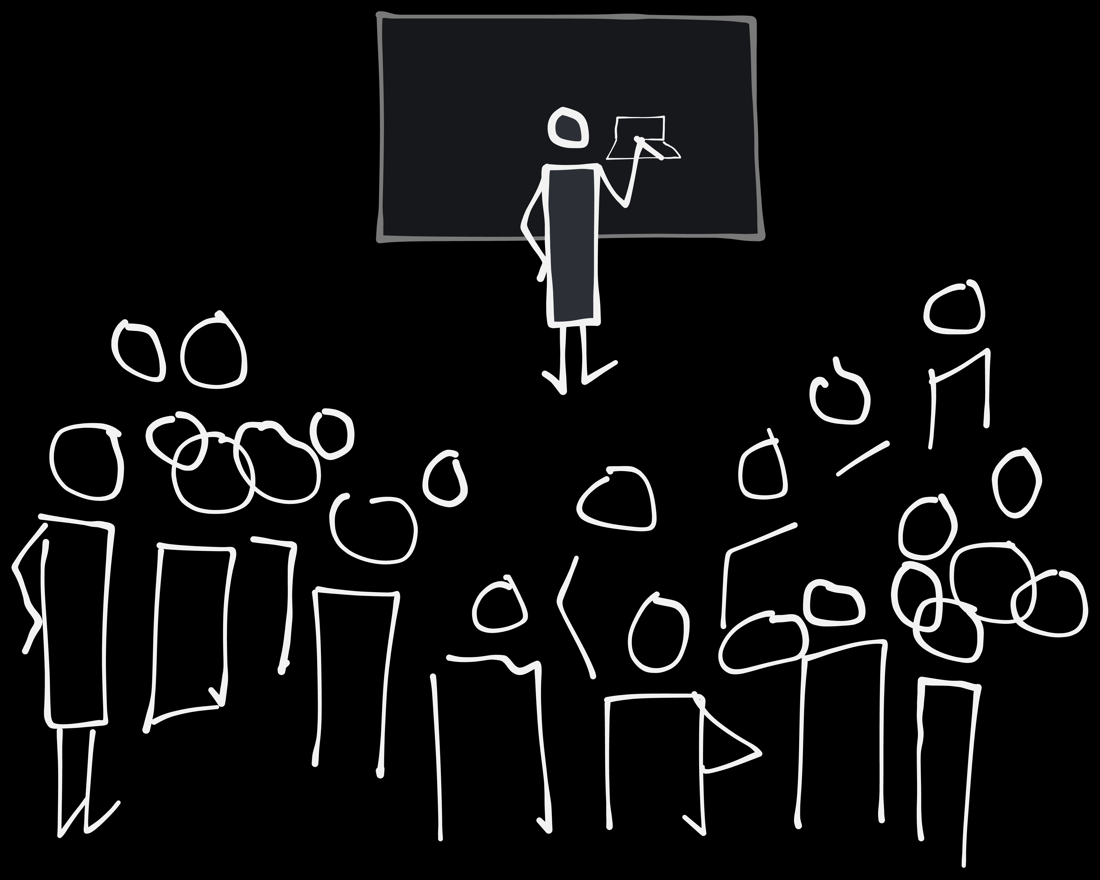
How to teach a million people to draw. Maybe...
By Espen Klem
Notes:
I'm going to tell an ongoing story I have on: How to teach a million people to draw. Maybe...

Slide 2
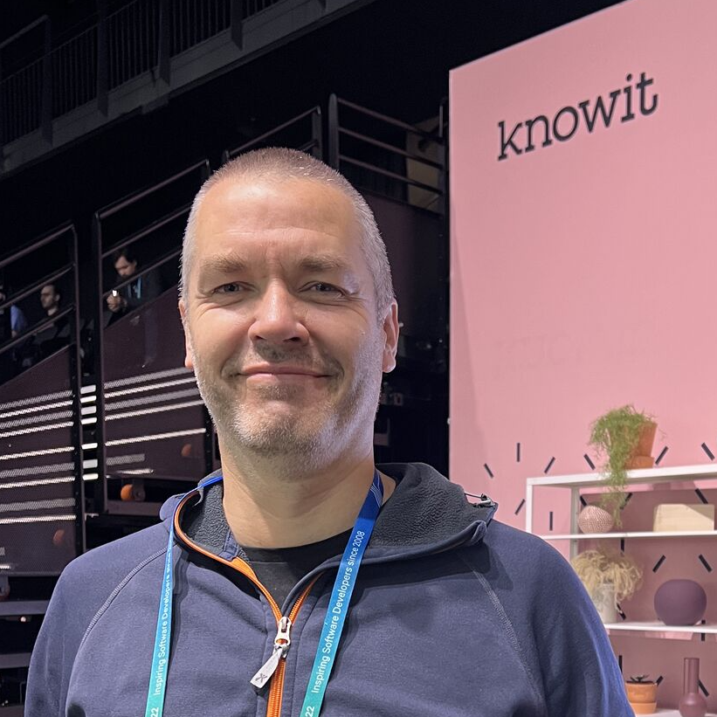
Espen Klem
28 years of web dev
Design
Frontend
Interaction design
Drawing to communicate
Notes:
Who am I?
28 years of web
Web design
Frontend code
Inteaction design
Drawing to communicate for the last 10 years – 5-6 years of trying to teach others.

Slide 3
The visual alphabet: What is it, and why
Notes:
As a helping tool for drawing to communicate we have:
The visual alphabet. So, what is it and why?

Slide 4


Notes:
It’s a small set of quite basic, shapes. There are many different visual alphabets as there are many different character based alphabets. This one is created by Dave Gray.
The intention of the library is to draw to communicate easier and with less cognitive effort.
The idea is that basing the things you draw on these shapes, you don’t have to think so much about how things actually look and how to be able to draw that.
Consists of:
dot, line, angle, arch, spiral and loop
circle, lense, triangle, rectangle, pentagon/polygon and a cloud

Slide 5

Notes:
You may remember this from 20, 30, 40 or maybe 50 years ago. It’s basic stuff, but it communicates.

Slide 6

Notes:
And our world isn’t that complicated to draw either.

Slide 7
Why draw at work
Notes:
This is not art, it’s communication. The intention here is that you draw to communicate. Everyone can master it. For that to work there are two things that matterrs:
That you draw fast enough
That what you draw precise enough
To draw precise enogh you have to have a clear understanding of what you want to communicate. My experience is that drawing helps for that to. Quite often I skip ideas I initially thought was good after trying to draw them.

Slide 8

Why draw...
Notes:
So, the first thing drawing helps with is better thinking and sorting ideas

Slide 9
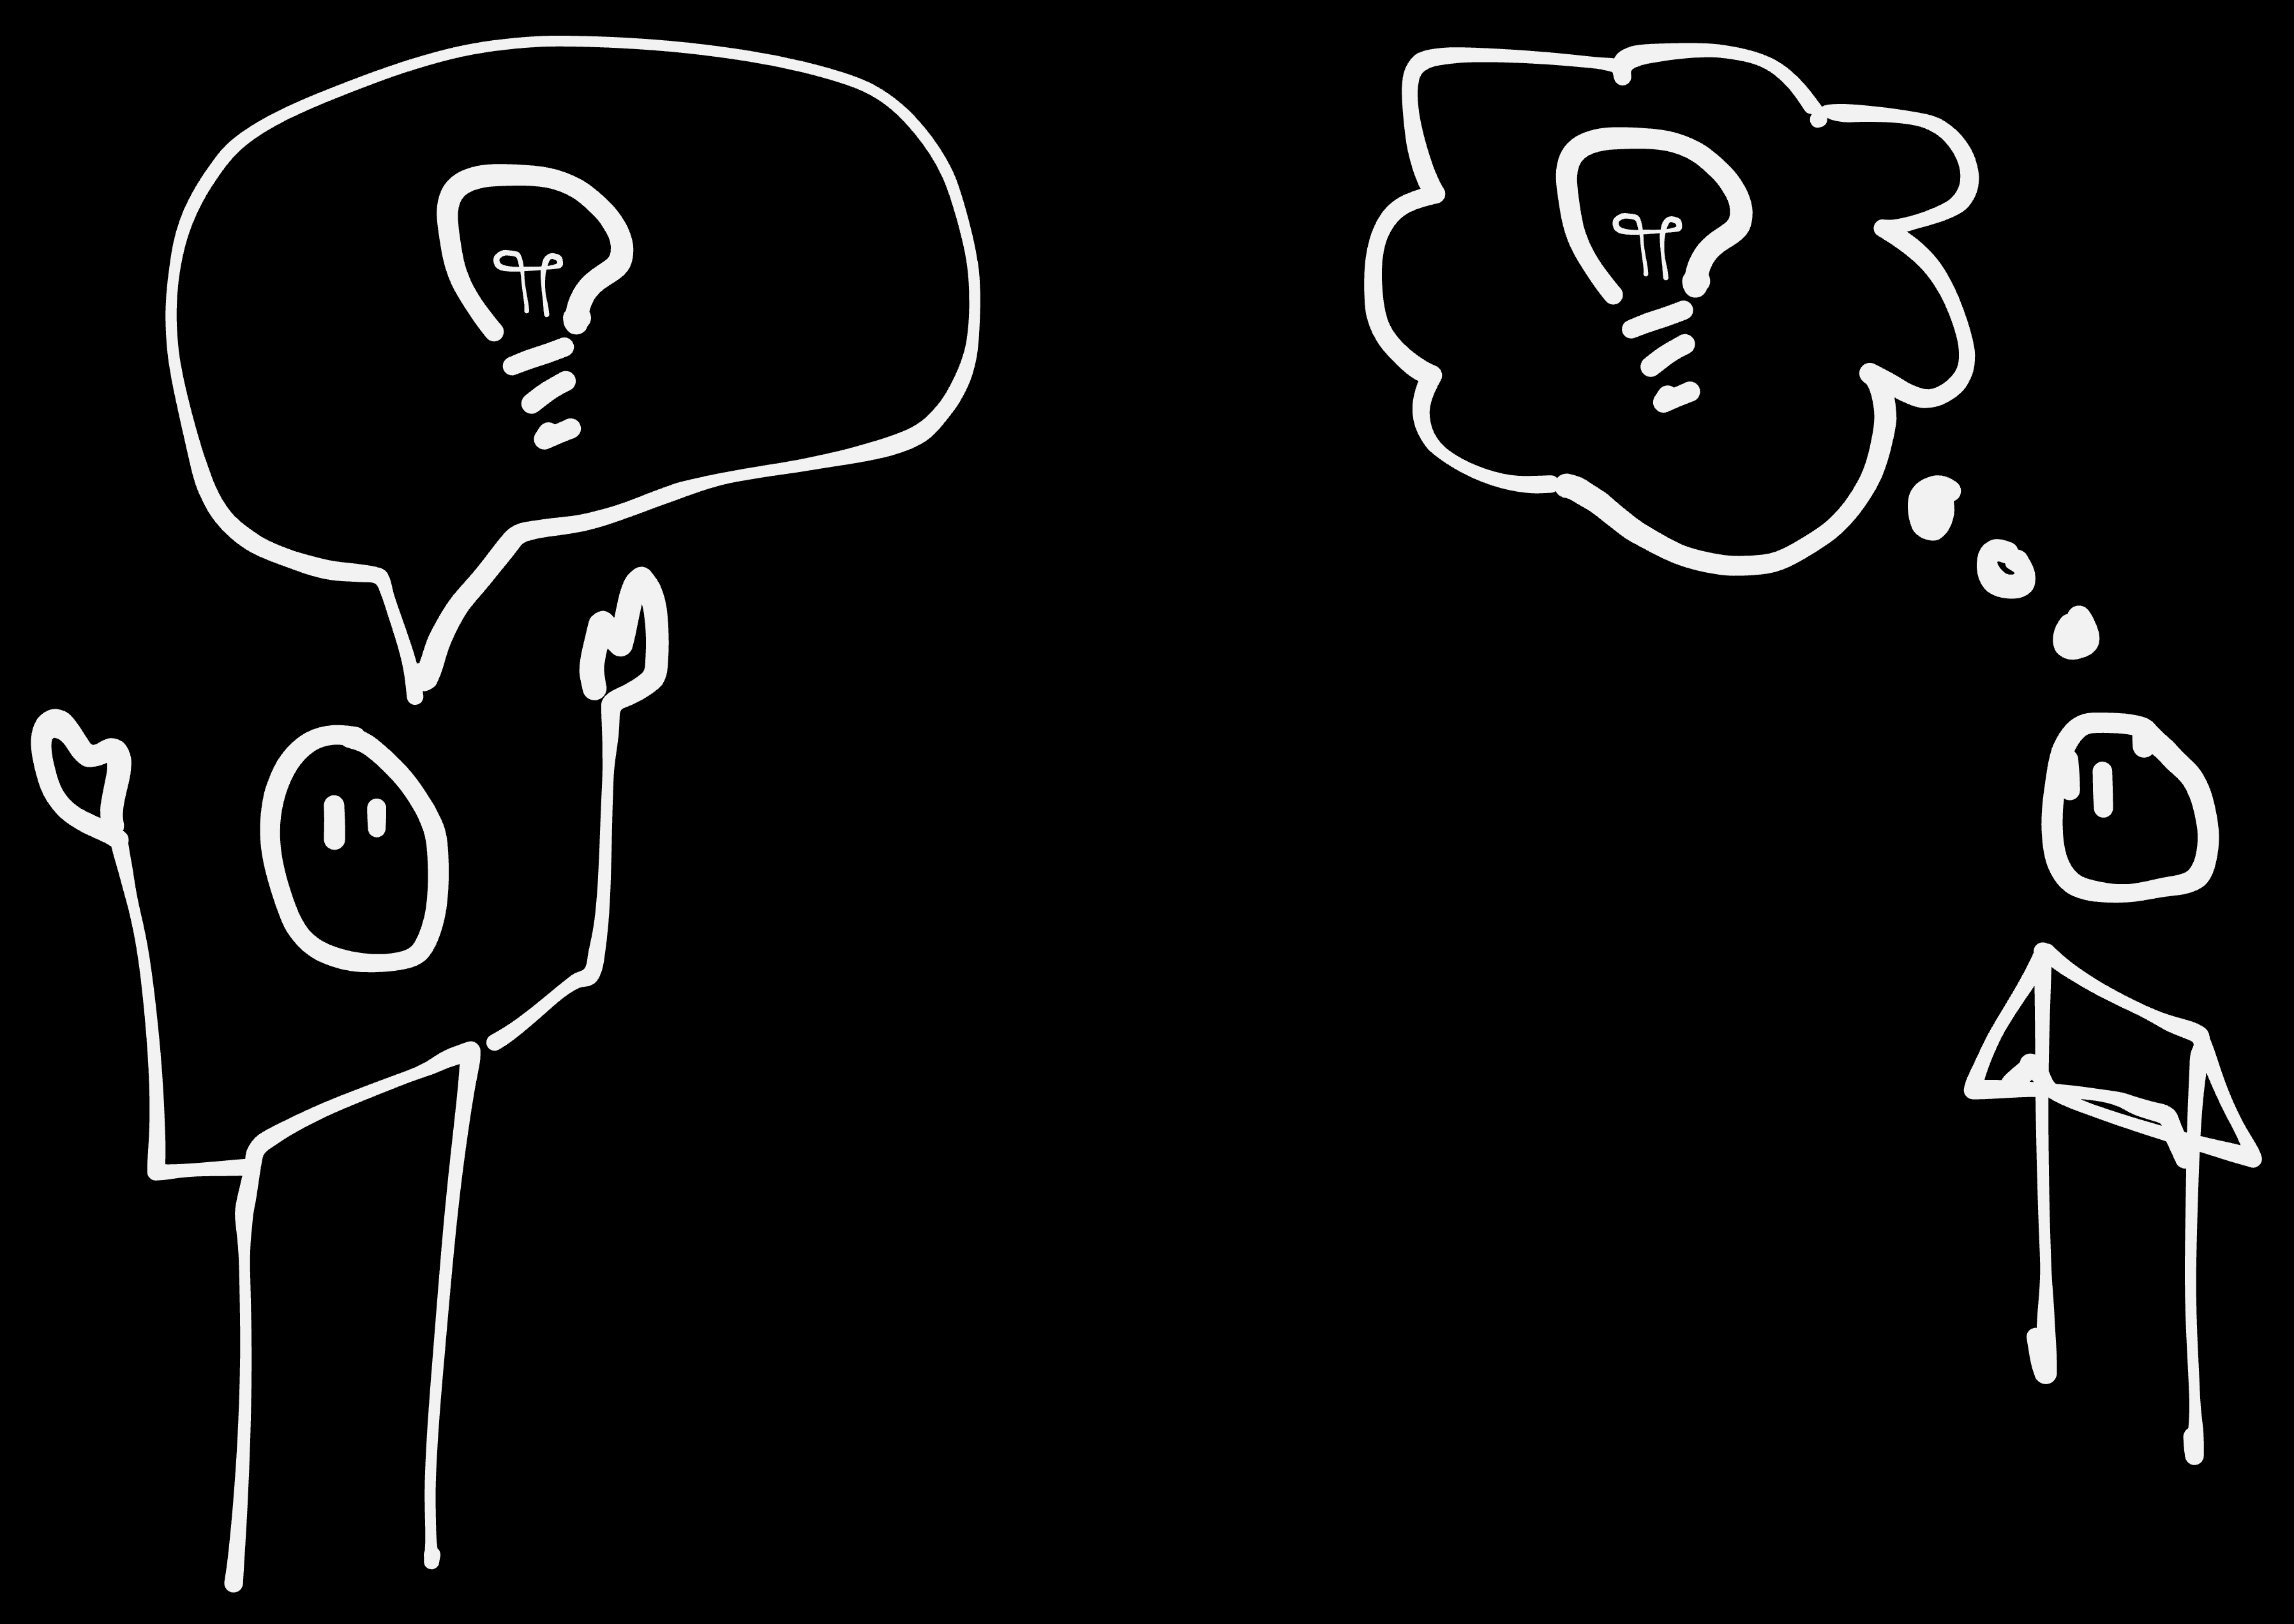
Why draw...
Notes:
And then better communicating those ideas. And of course getting feedback or reactions

Slide 10
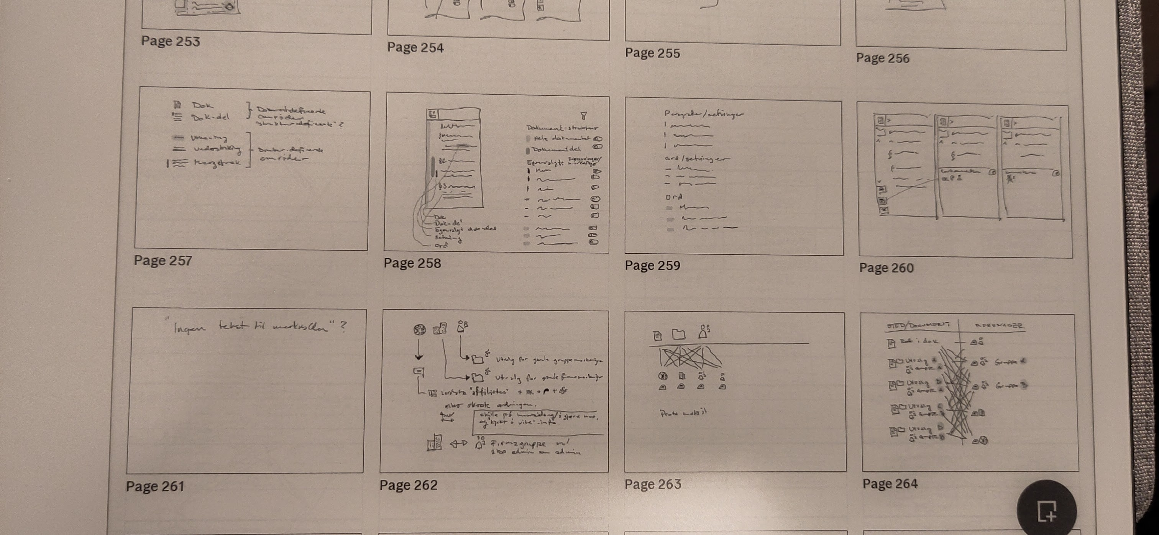
Why draw...
Notes:
Here are some examples from the customer I’m working for now.

Slide 11
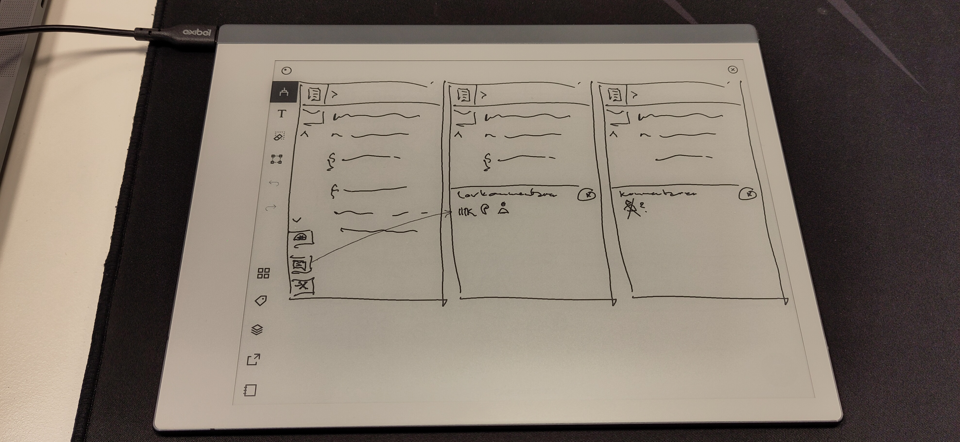
Notes:
Most are just ideas on how to solve different interaction design issues, like this one. It’s to try to think better.

Slide 12
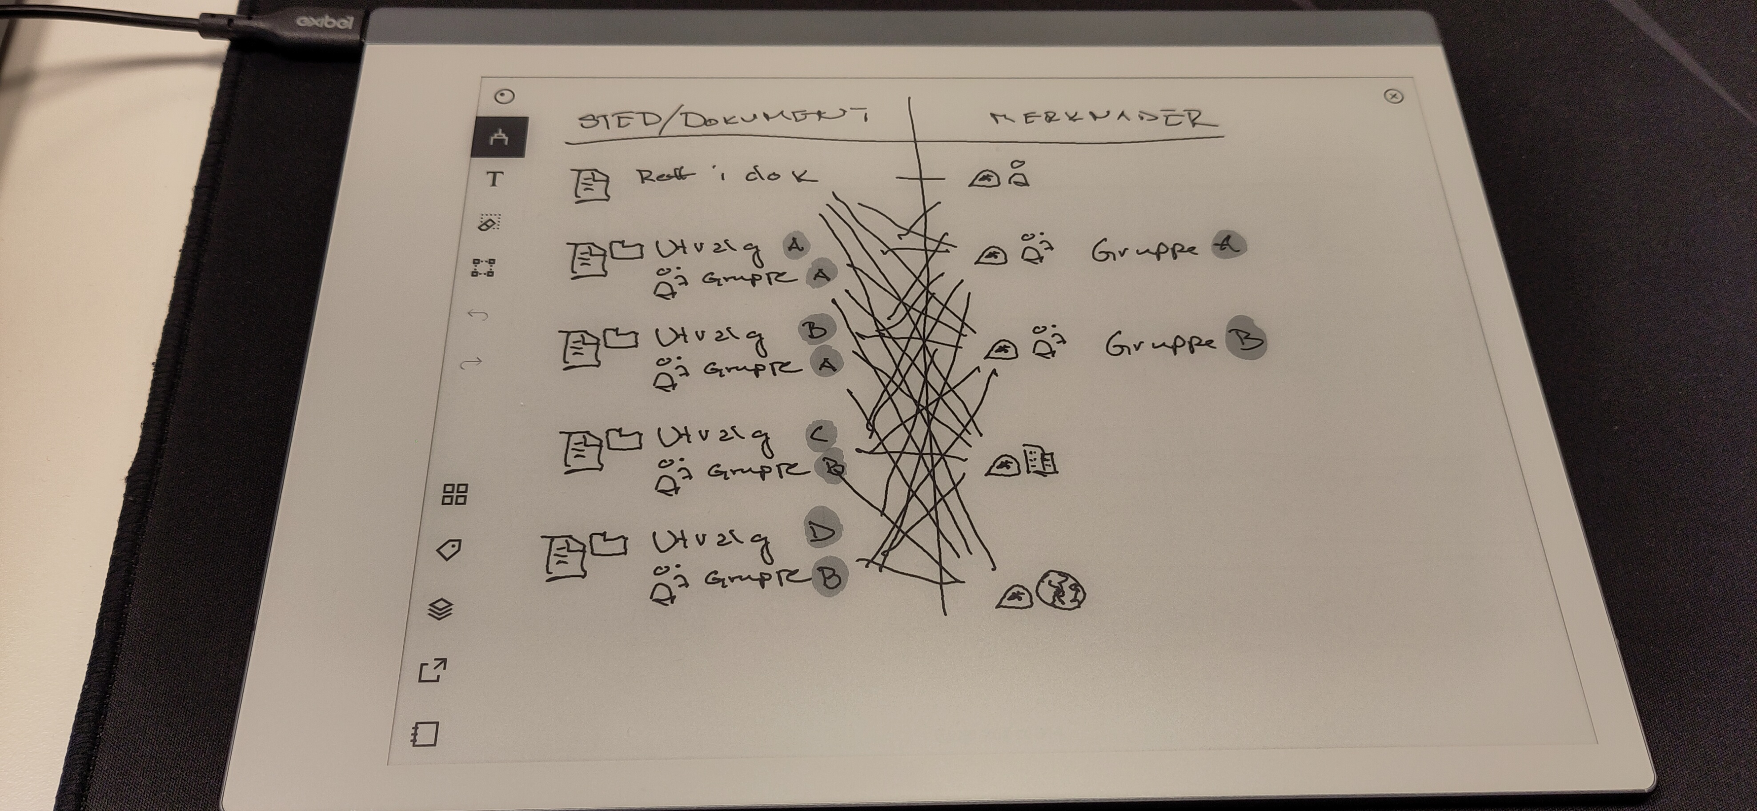
Notes:
And here I’m trying to convince the team that we are creating some issues for ourselves with how they wanted to solve a certain issue. We would create a lot of extra choices for the user, that we didn't have to.
Or more correctly, figuring out for my self why it was a bad idea, and figuring out how to communicate it to the team. Before I drew this I had a hunch that what we were doing wasn’t so smart. After drawing I knew why. And that presentation ended a discussion we’ve had over the last 2-3 years.

Slide 13
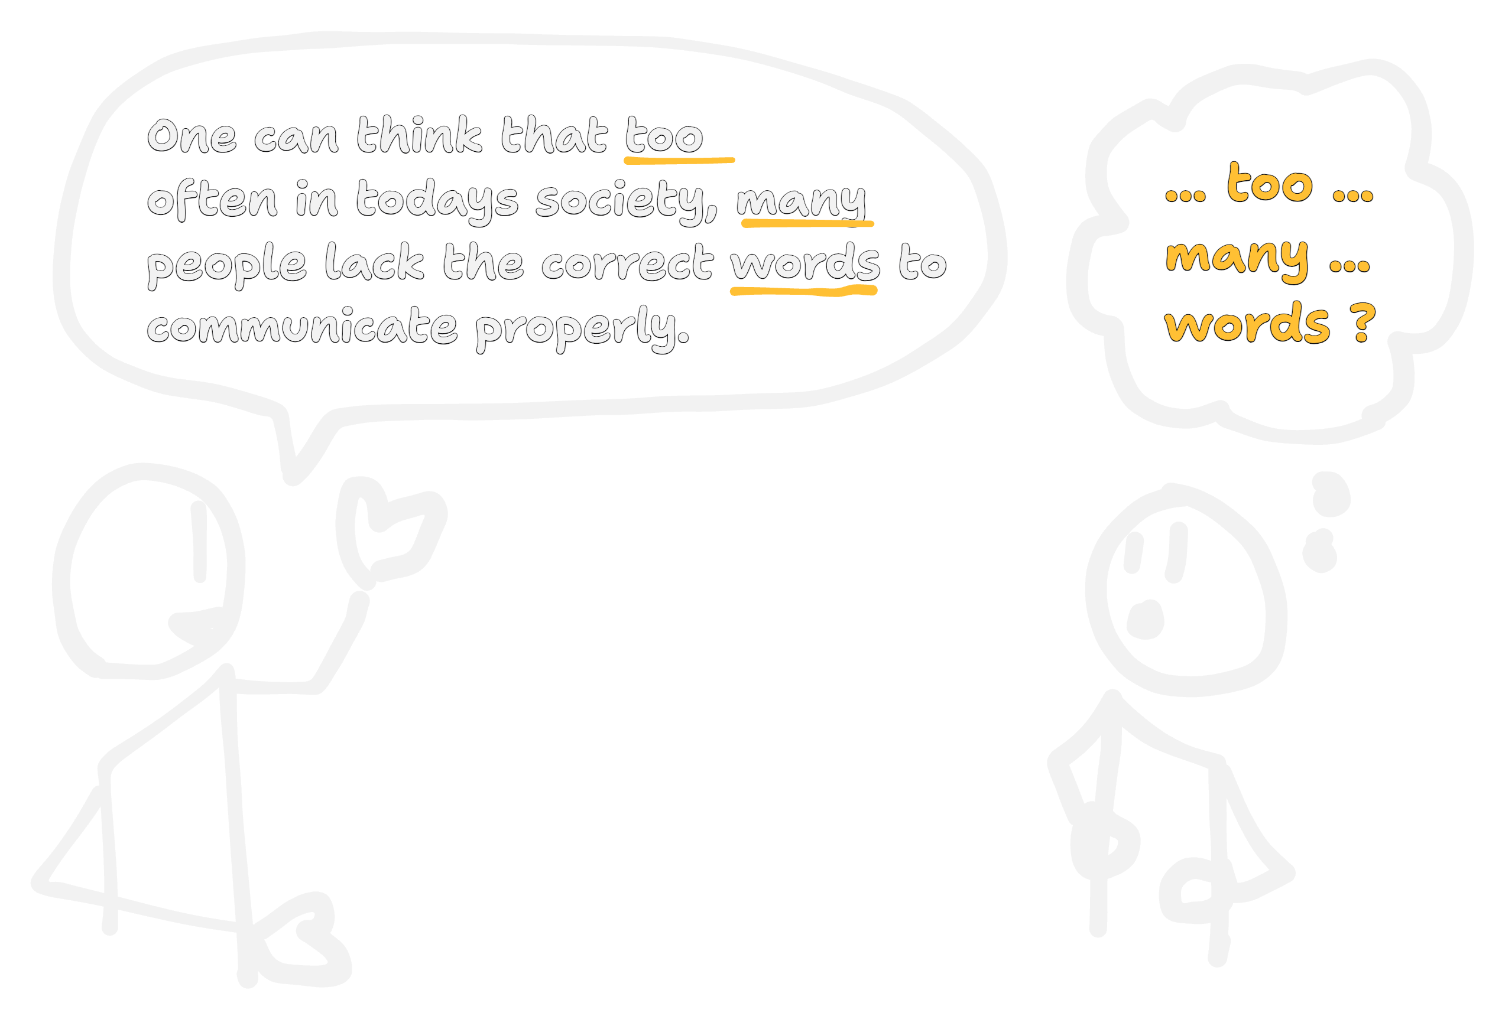
Notes:
Aslo, words don’t work that well. We use a lot of them all the time, we’re just not that good at it. When talking or sending an email, if you could listen to what the recipient would acutally understand or take away from it, I think you would be sad. I don’t say we shouldn’t use words, but maybe less of them, or accompany them with drawings.

Slide 14
Figuring I could teach others
Notes:
Figuring out I could teach others.

Slide 15
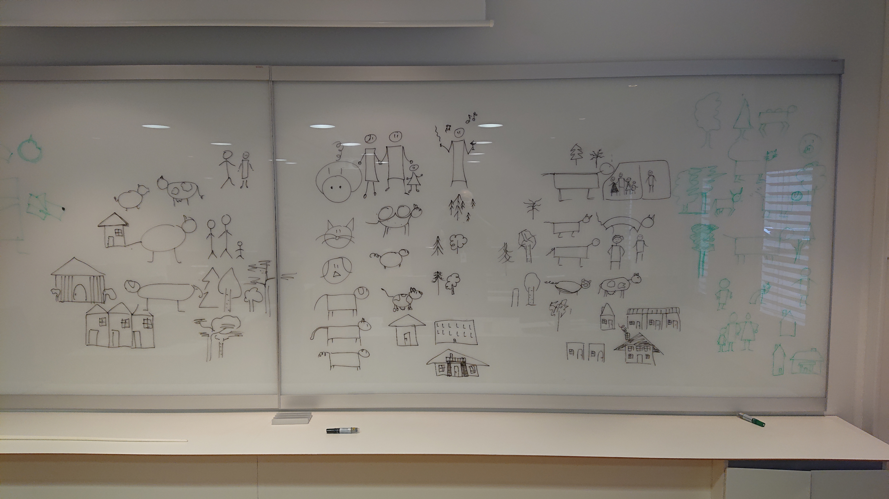
Notes:
At a previous customer, an insurance company, I understood that I may be able to teach others how to draw to communicate. So, I set up a workshop and held it a couple of times at an internal conference.

Slide 16
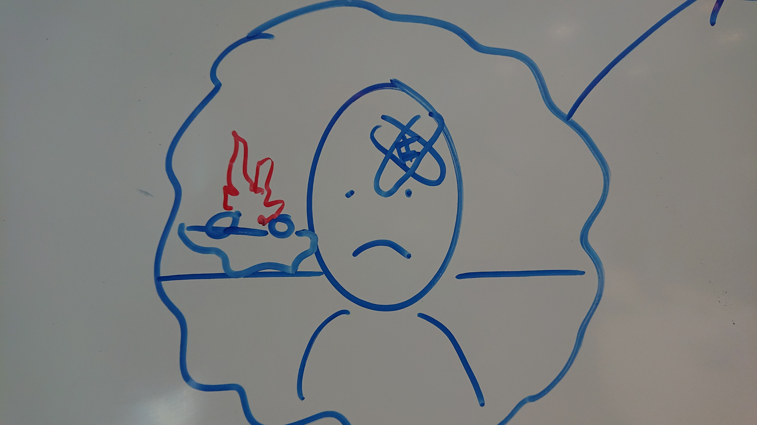
Notes:
They got the idea pretty quickly.

Slide 17
First take on making it scale
Notes:
And then, I wanted to make it scale, and had my first take on that.

Slide 18
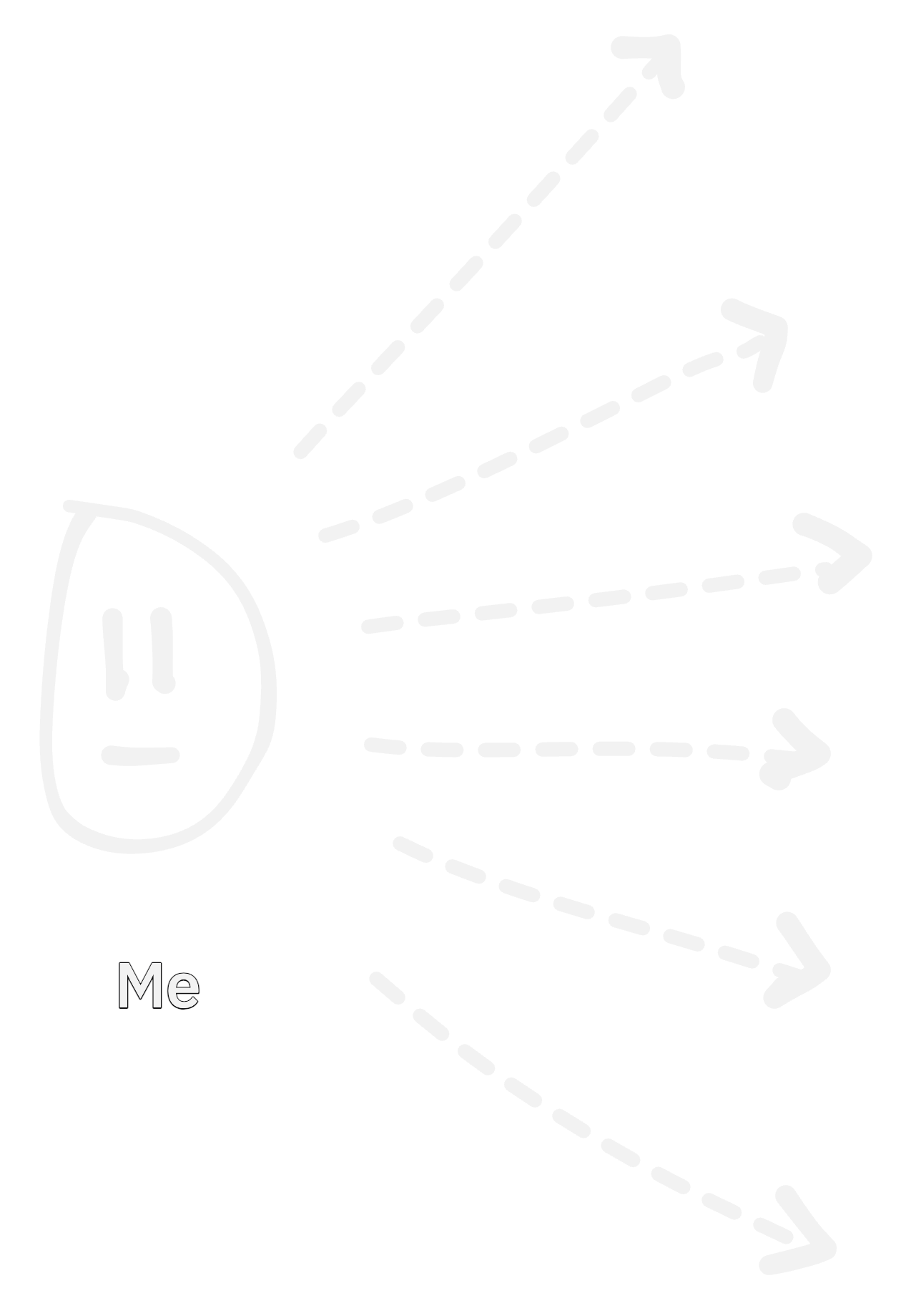
Notes:
I think drawing as a communication skill is a super power. And I want to teach a lot of people how to draw. Physical workshops can be fun, but they definitely don’t scale.

Slide 19
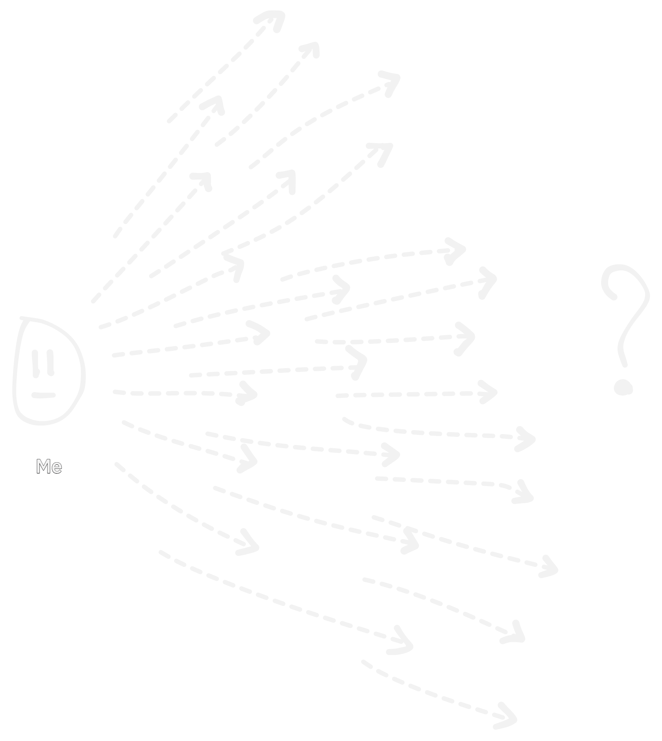
Notes:
And I really want to reach and teach a lot of people. But how?

Slide 20
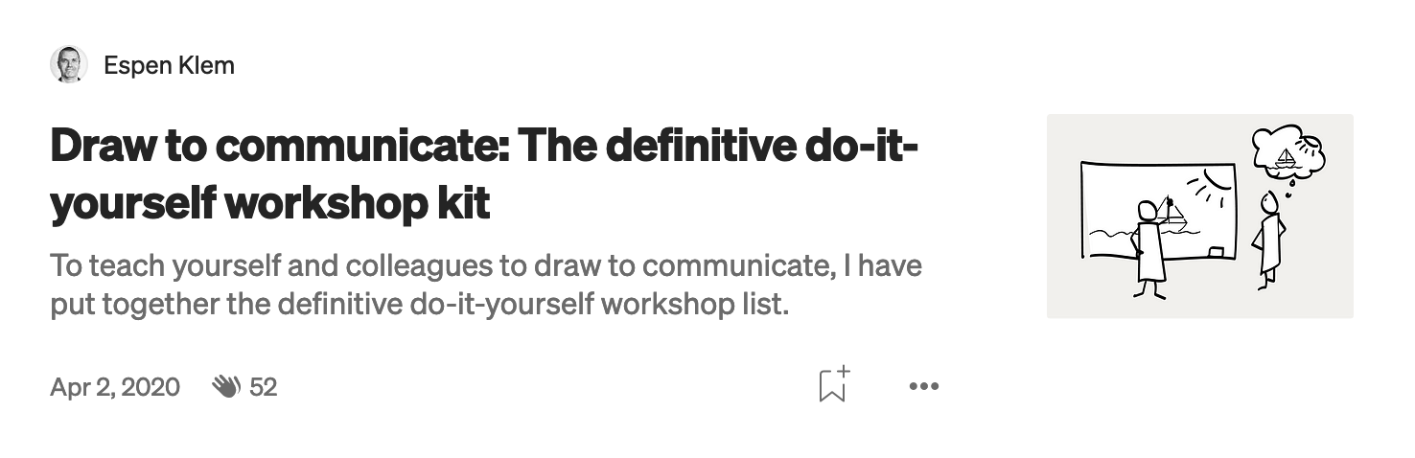
Notes:
I made a series of blogposts describing how to set ut a 4-part workshop for yourself and your colleagues. It was good to sharpen the ideas on what content needed to go into the different workshops and how to communicate them.

Slide 21
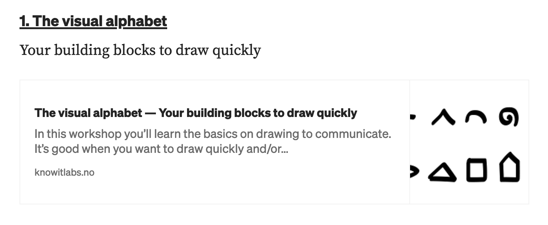
Notes:
Part 1 was just getting familiar with using the visual alphabet.

Slide 22
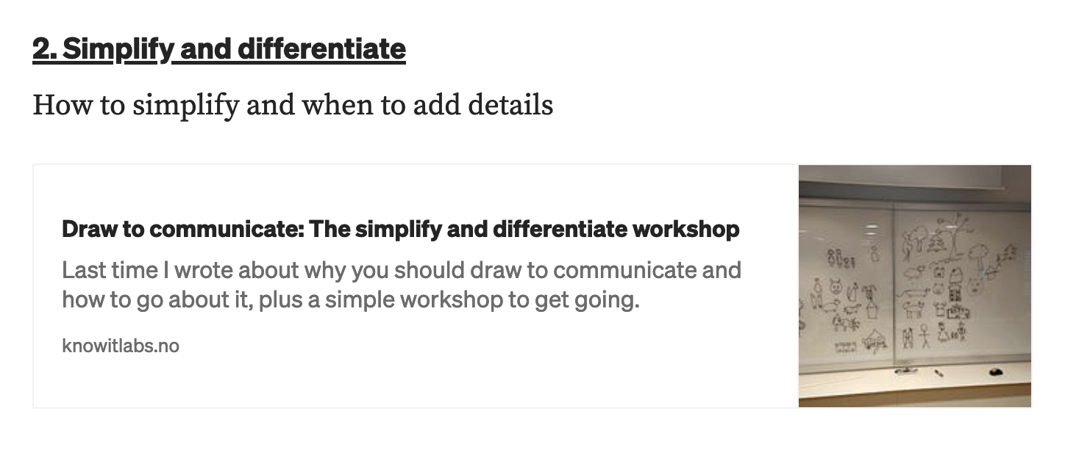
Notes:
Part 2 about how to draw simple enough to draw quick and also have the necessary details to communicate the precision you actually want.

Slide 23
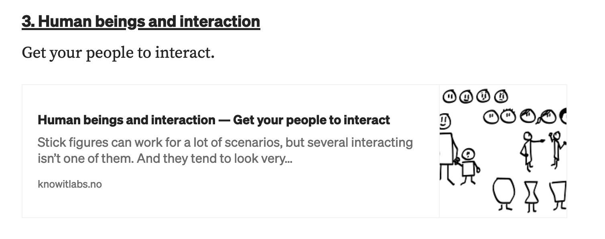
Notes:
Part 3 was about how to draw human beings and interaction between those human beings.

Slide 24
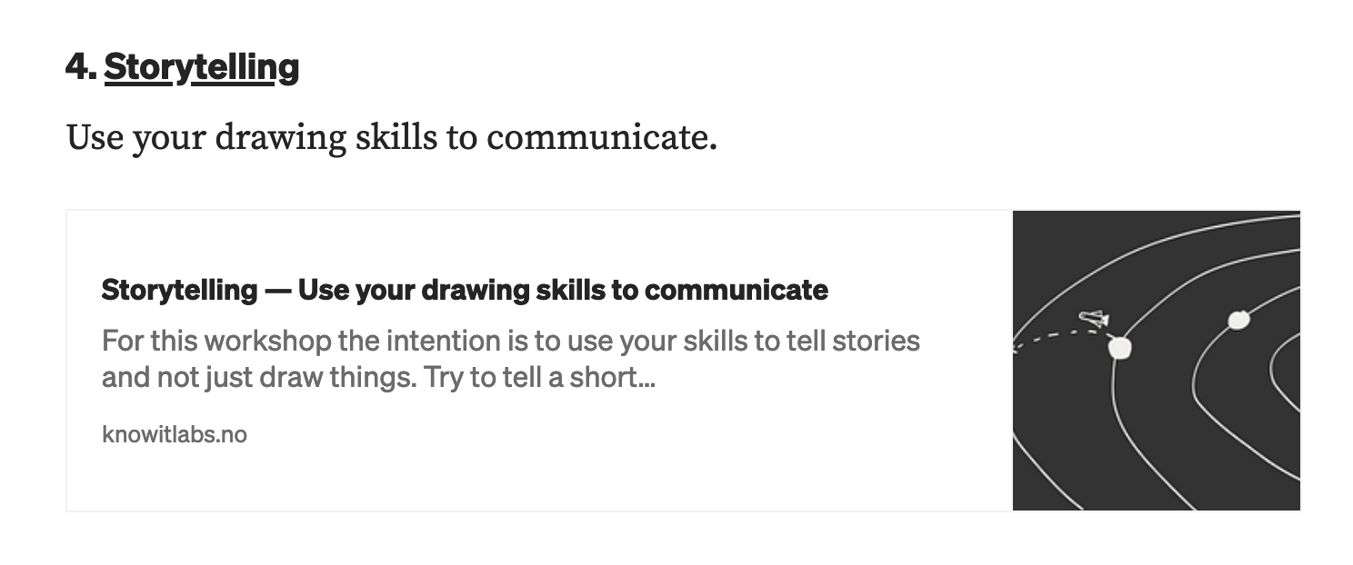
Notes:
Part 4 was kind of testing your skills, trying to tell stories related to work through drawings. And of corse, part of communication is telling stories.

Slide 25
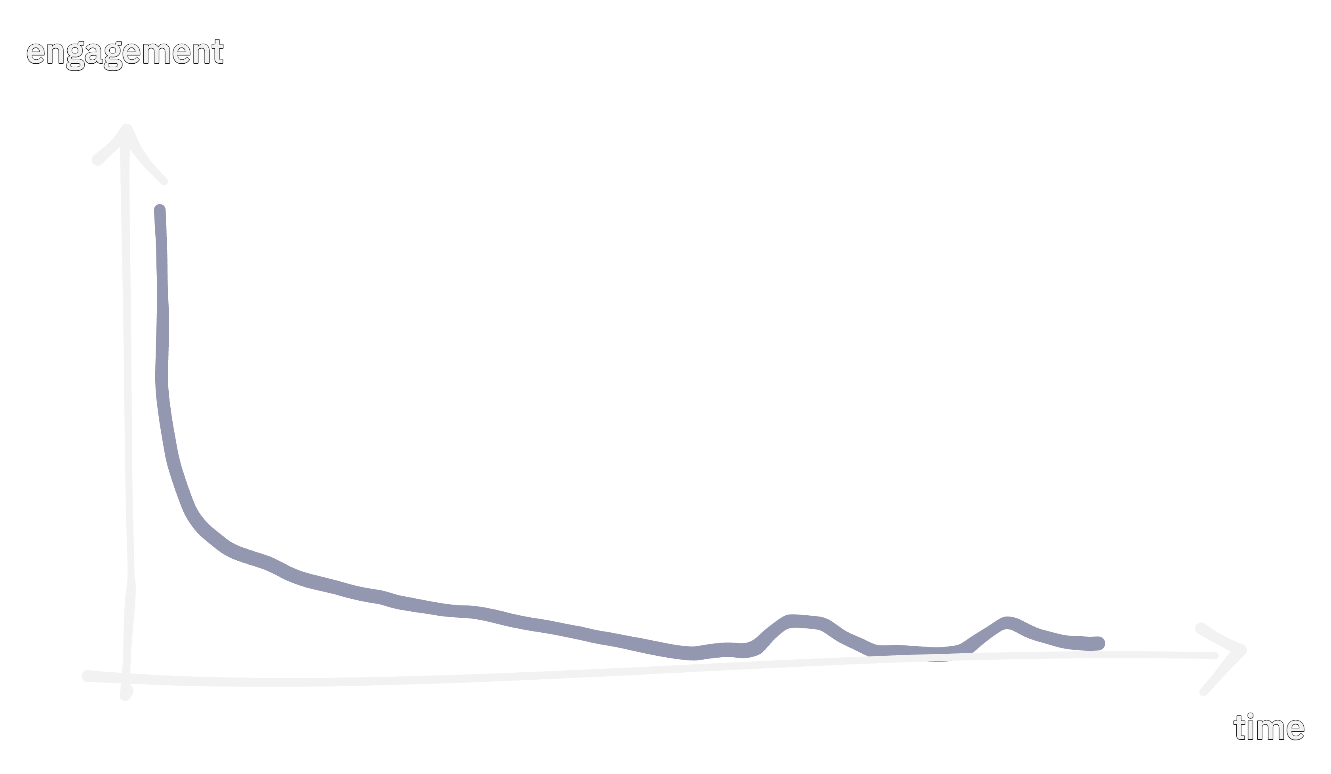
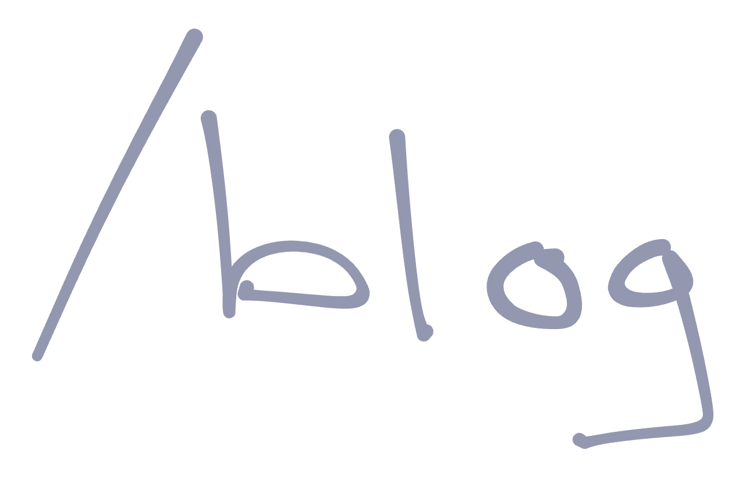
Notes:
But blogposts. They never reache a lot of people to begin with and really quickly, nobody read them at all. The volume of the long-tail is close to zero. It’s mostly the nature of blogposts.

Slide 26

Notes:
Also, I wanted people to go from a blogpost to somewhere not very concrete. A whiteboard maybe. Miro, or something else of their choosing. You have to have a pretty convincing blogpost to manage that.
So a small fraction of all people will read the blog, and then a small fraction of those again would maybe try to run the workshop. The math isn’t very convincing.

Slide 27
Covid: Online workshops in Miro - Still doesn't scale
Notes:
Then Covid came. And we tried online workshops for obvious reasons. The tool we used was Miro.
It still doesn’t scale.

Slide 28
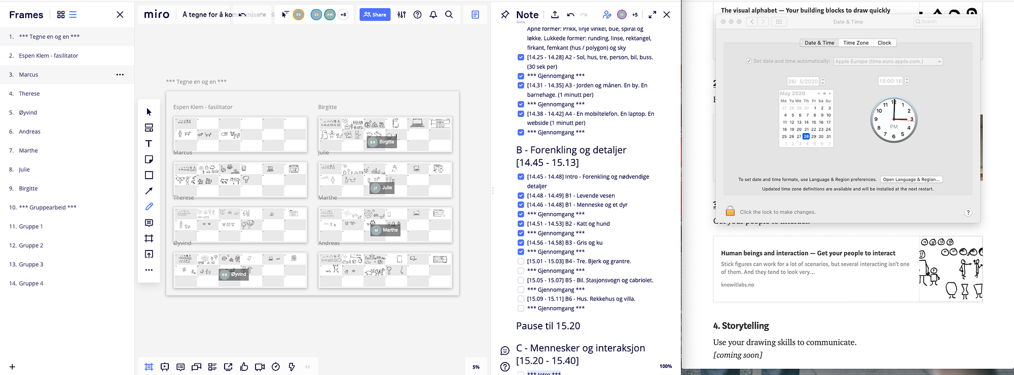
Notes:
I think I taught people to draw. But triggered very few to actually use drawing as a tool at work, that I know of. Also, Miro doesn’t scale when everyone draws. You can have a lot of people in Miro, but not when they all draw. Figured out that 10-12 people was max of what Miro could tolerate. After that you get syncing problems.

Slide 29
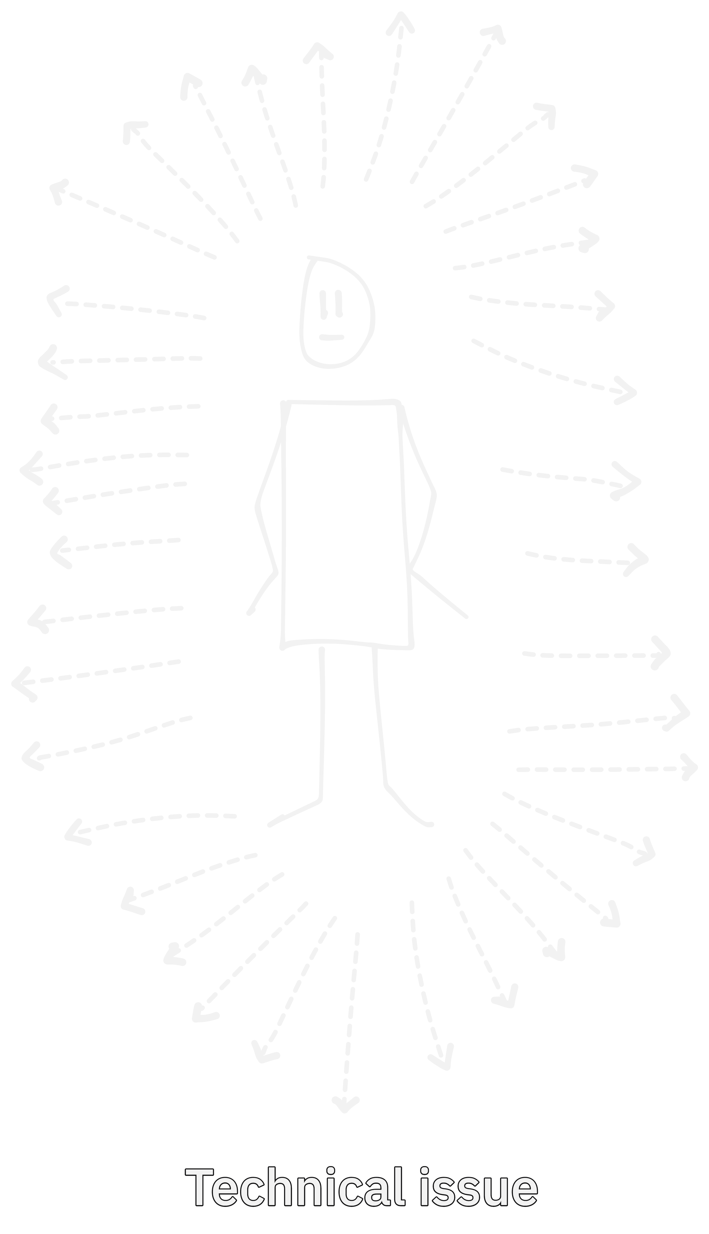
Notes:
And anyway. How many you can communicate to one way is maybe a technical issue. Miro failed at that, but does it really matter if we fix it?

Slide 30
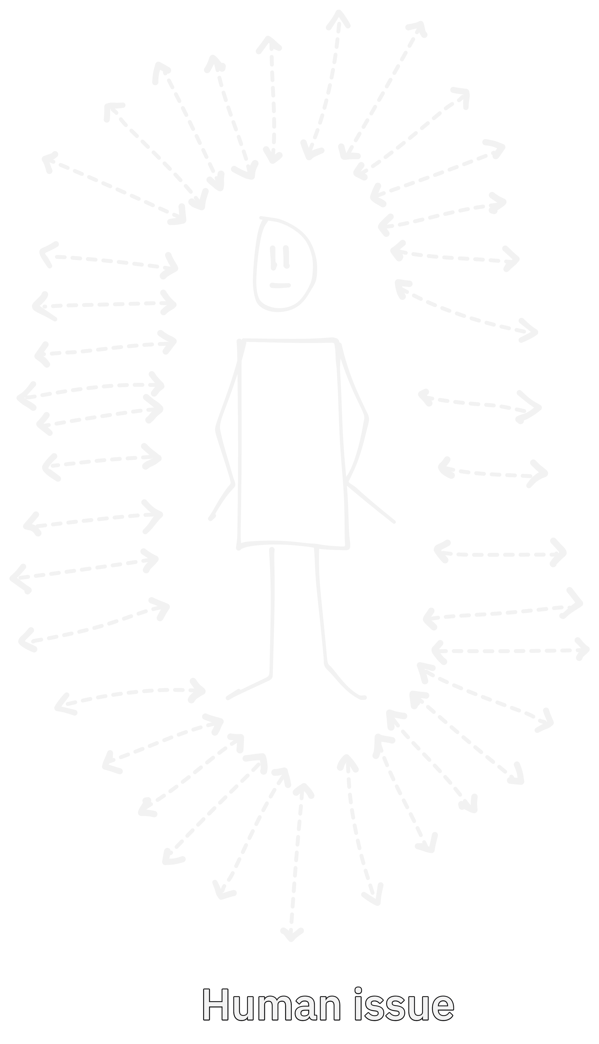
Notes:
Because: Actual communication – two ways, is a human issue. I don’t scale. So getting a better tool for this or waiting for Miro to fix their issues wasn’t the way.

Slide 31
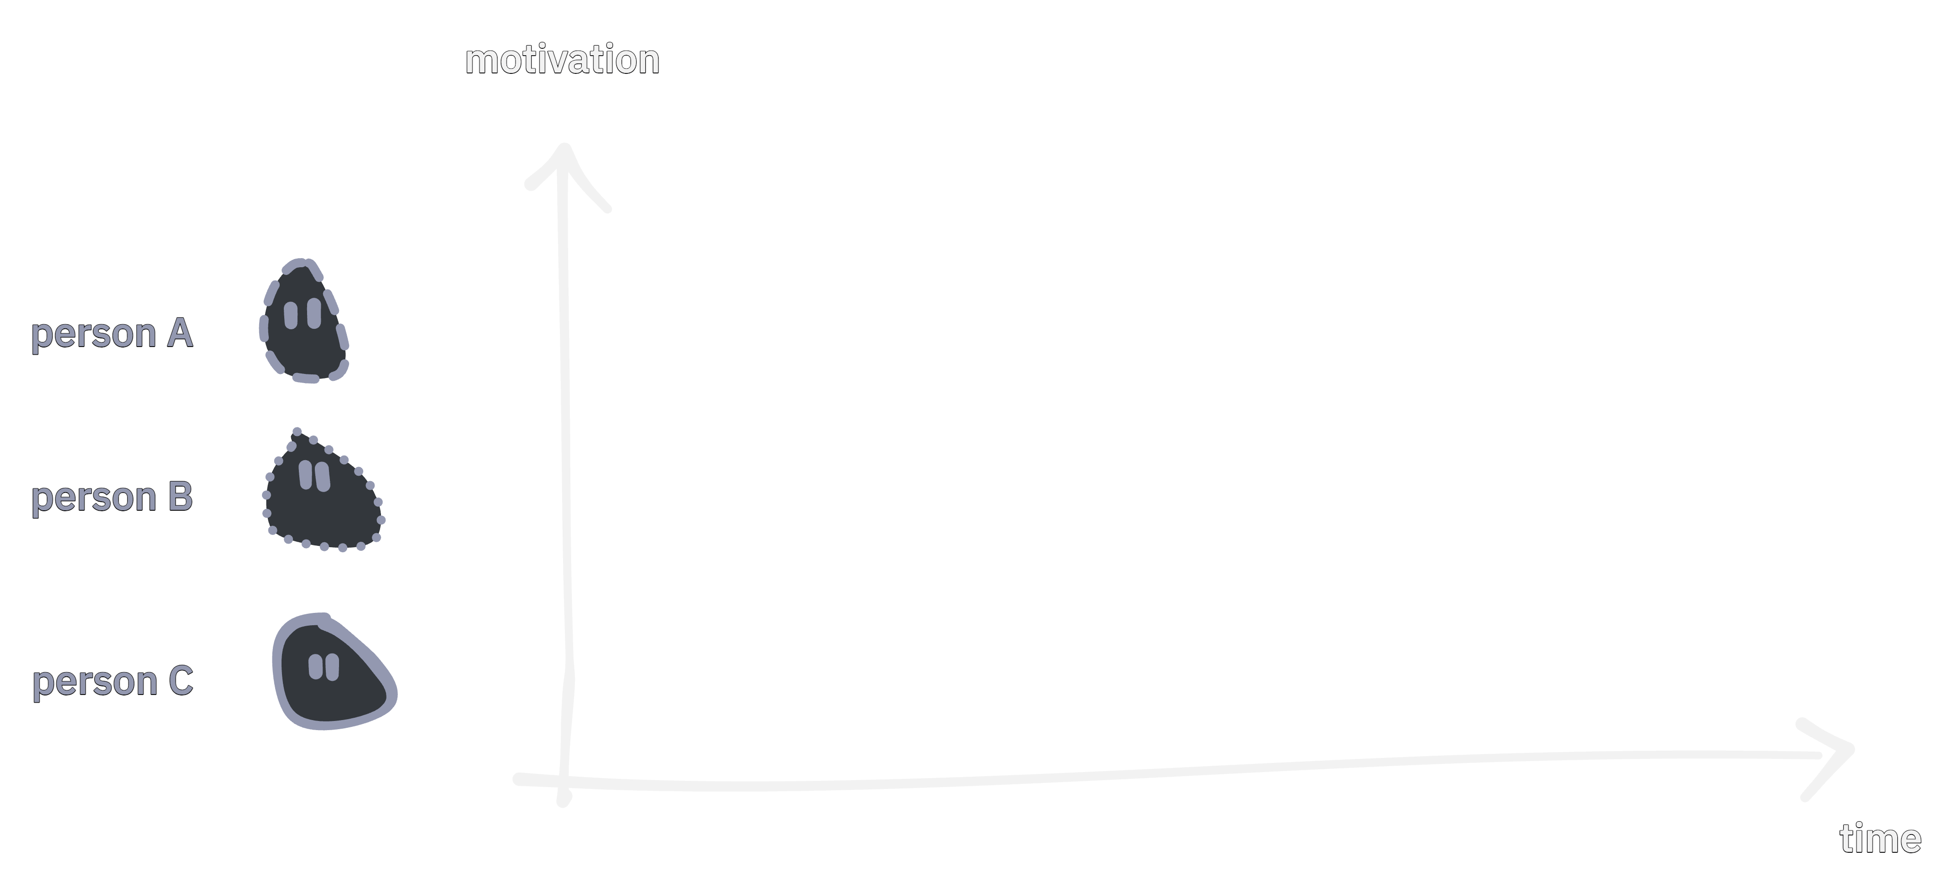
Notes:
In addition I think I mostly didn’t hit the moment when people was motivated. This may address that people got to understand they could draw, but didn’t continue drawing.

Slide 32
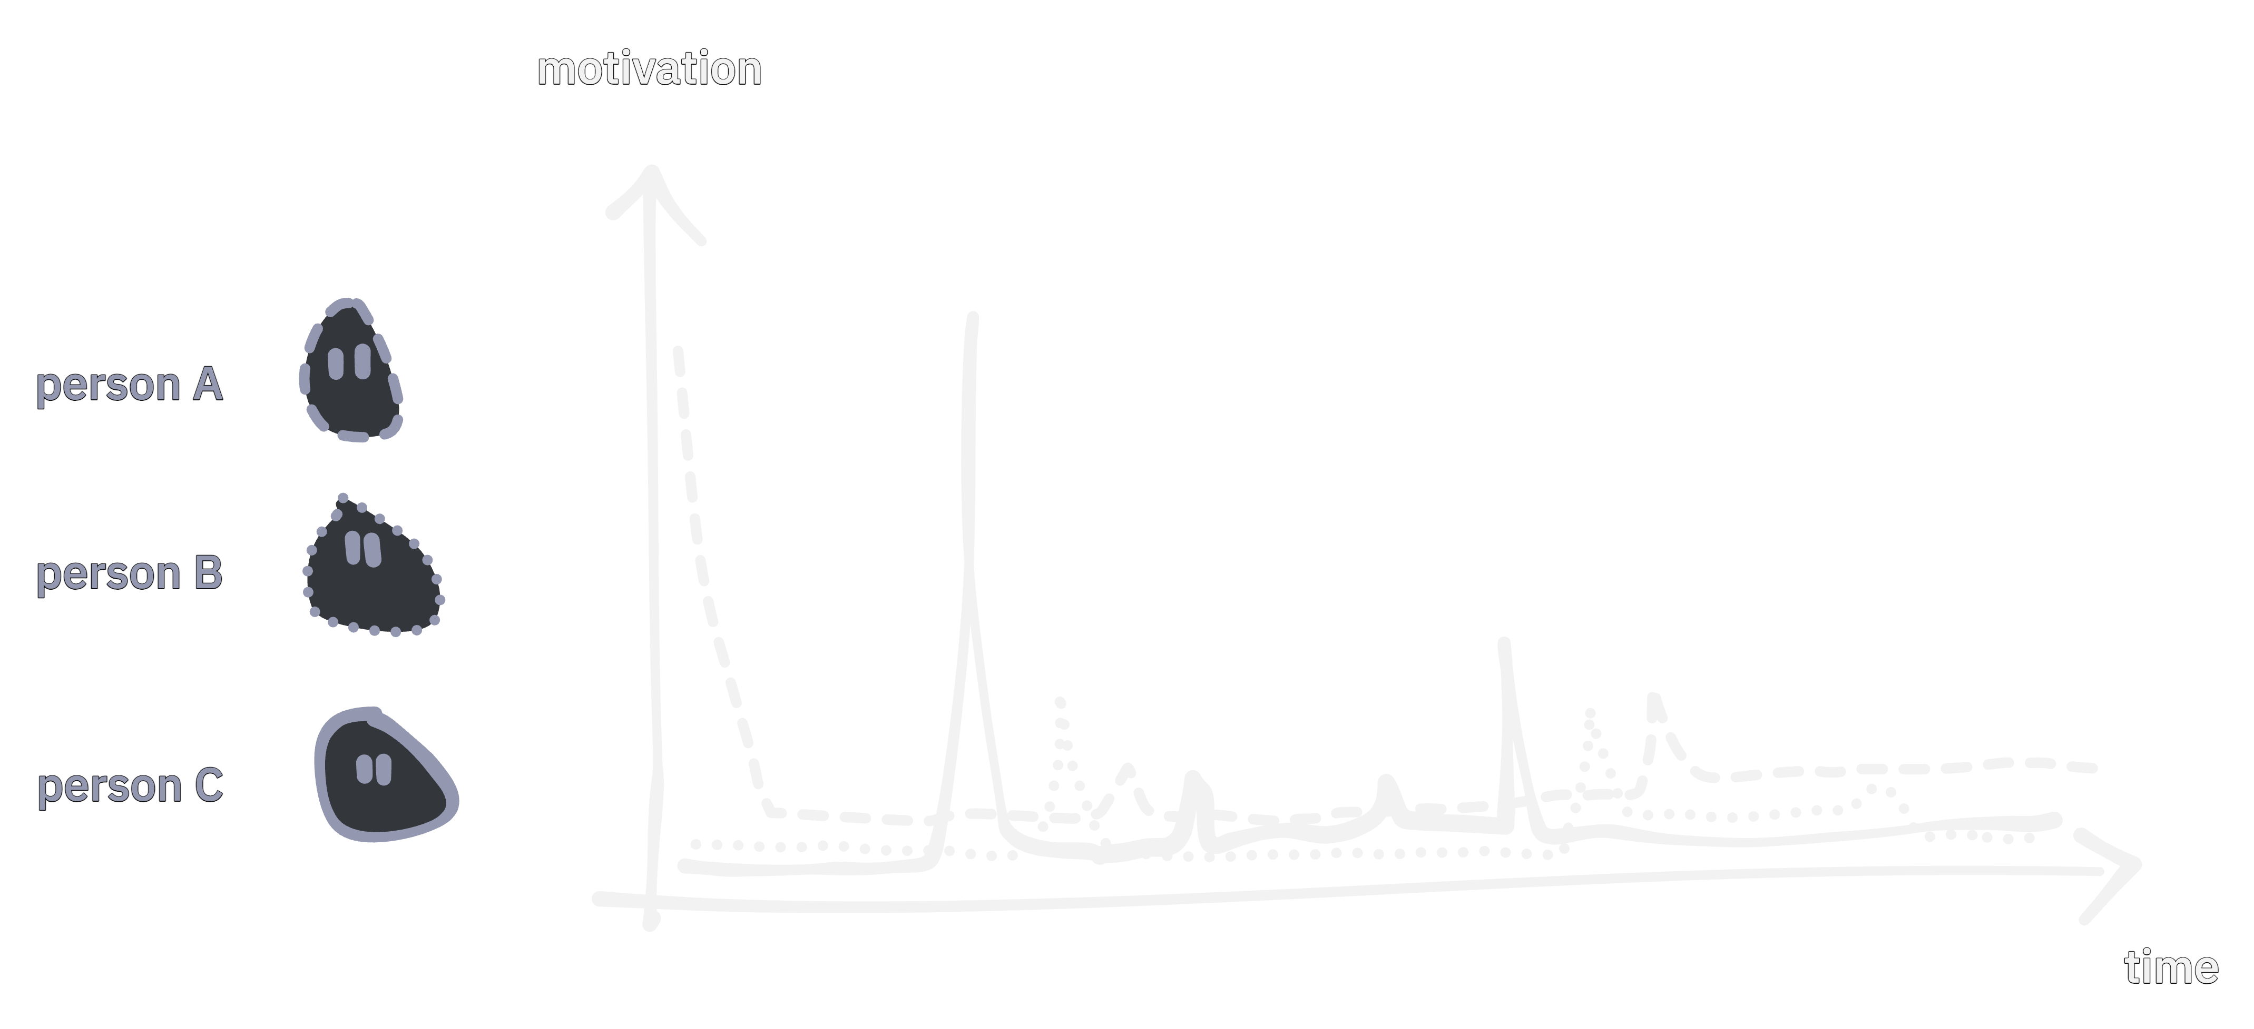
Notes:
If you have time on the X-axis and motivation on the Y-axix. People learn better when they see a usecase for what they are learning. That happens every now and then at different times for different people.

Slide 33
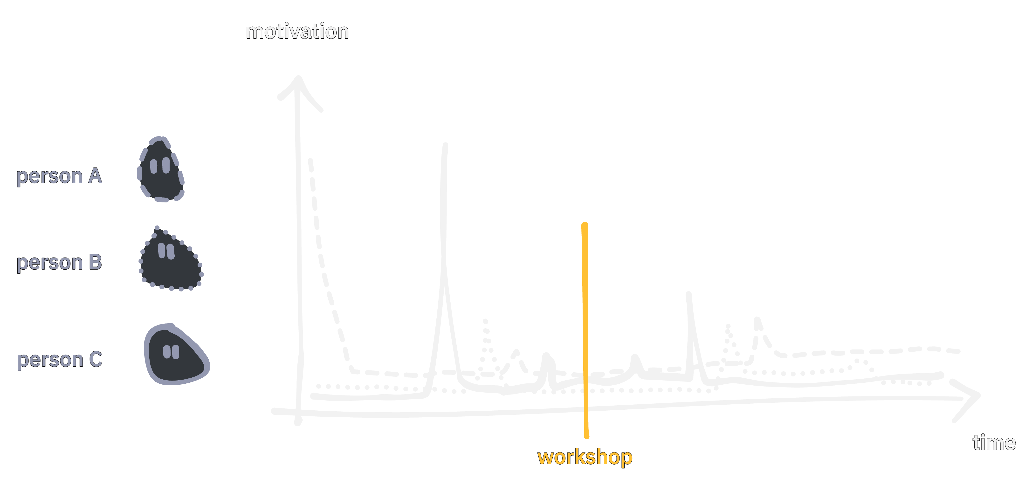
Notes:
And there is no way to hit that spot through a workshop set to a specific time. At least not for a lot of people at the same time.

Slide 34
How did I learn to draw
Notes:
Which brings me to how I learned to draw.

Slide 35

Notes:
* A colleague of mine had been to a talk about the visual alphabet. Dave Gray created it – a woman for whom I don’t have a name presented it at Yggdrasil, a conference here in Norway

Slide 36
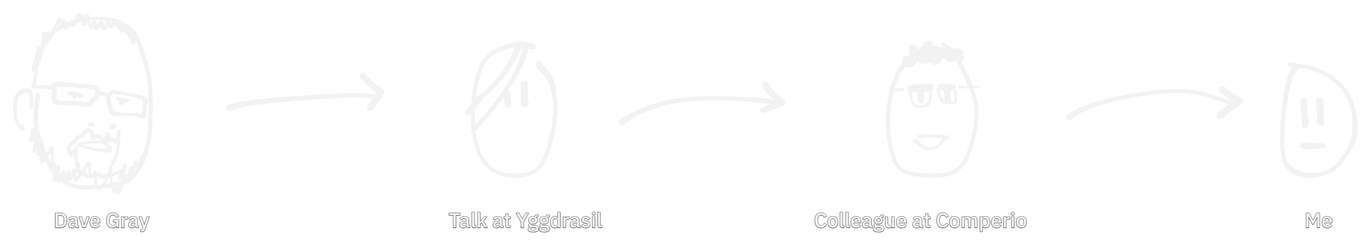
Notes:
* He presented it to us at work and the reason behind the visual alphabet.

Slide 37
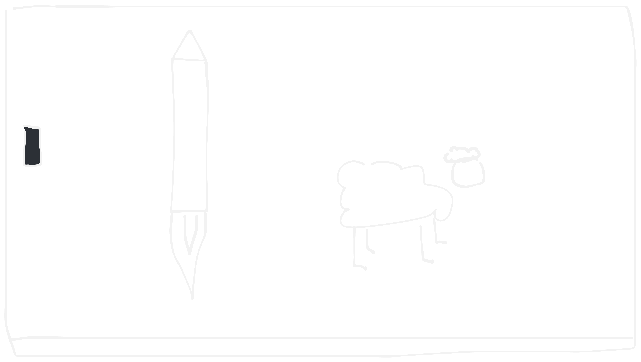
Notes:
We challenged each other to use the visual alphabet to draw different things. And it worked. But we didn’t draw anything for actual work purposes.

Slide 38
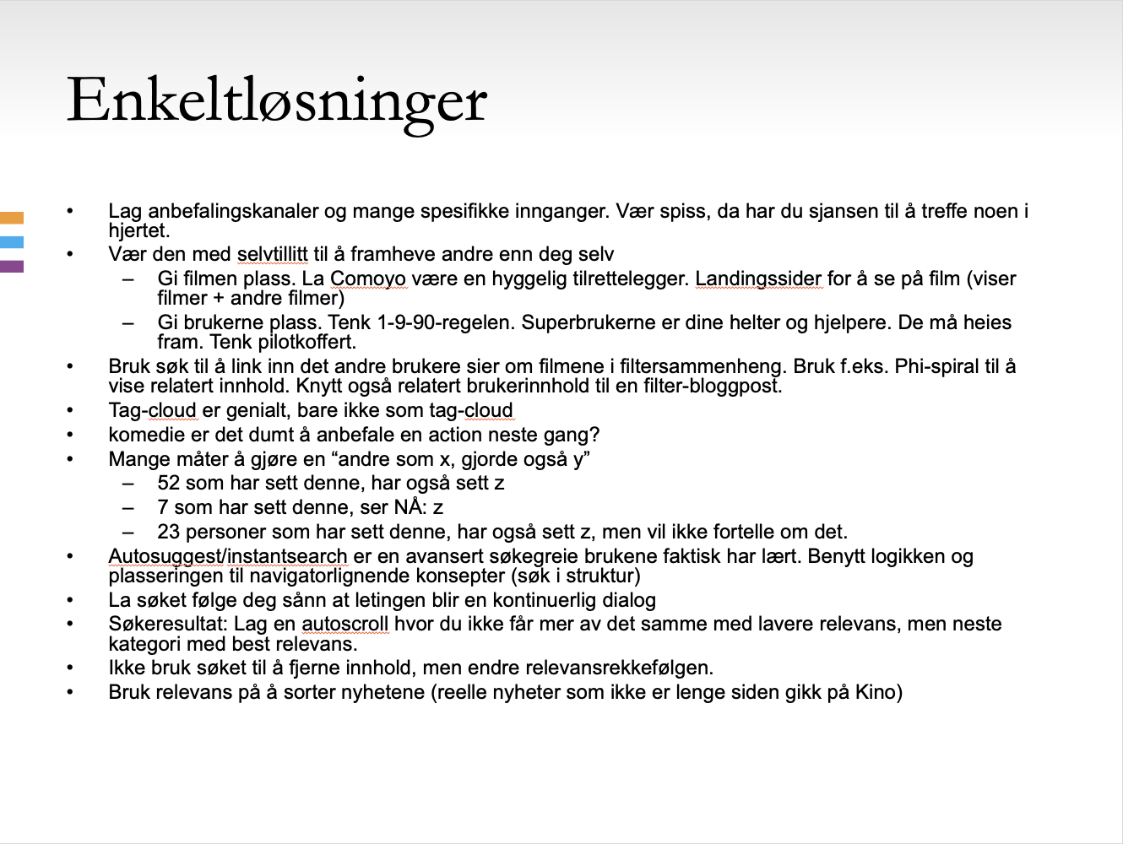
Notes:
Then I had a pitch to a potential customer that I wanted to make. After a lot of pain and text heavy slides with notes I started to draw.

Slide 39
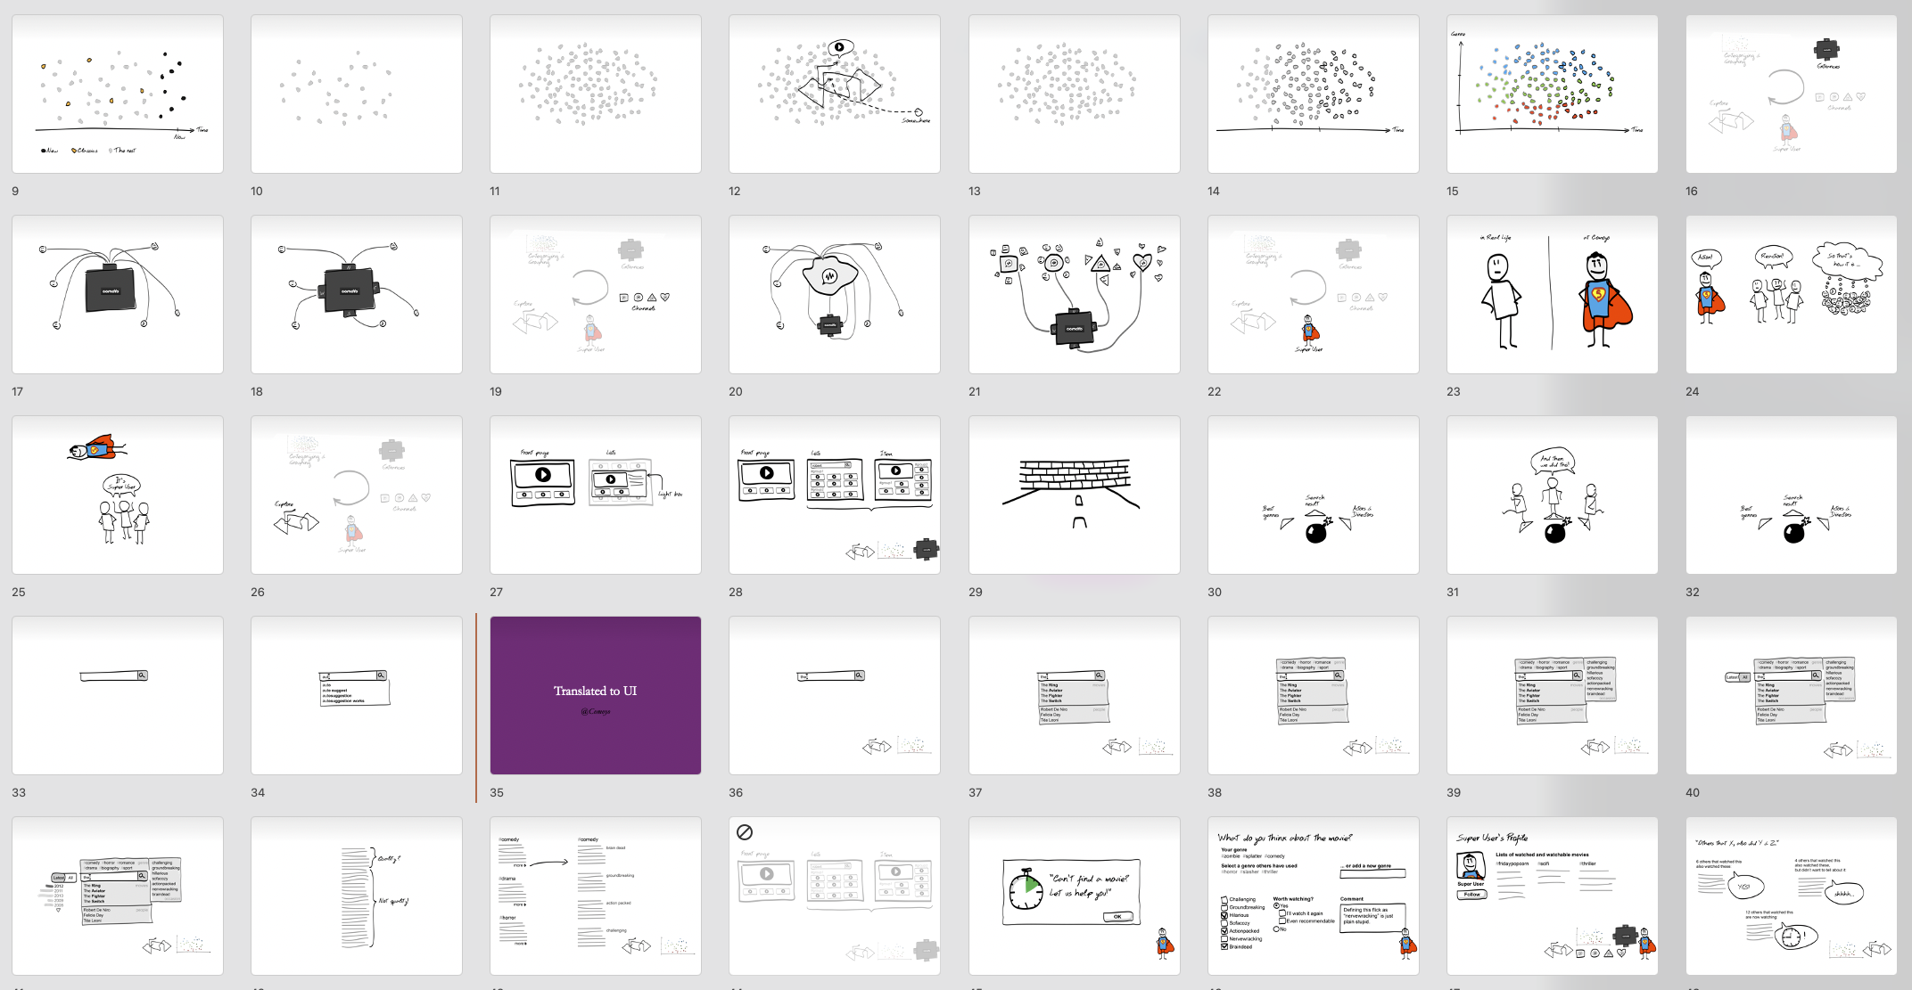
Notes:
It became a 40-page cartoon, telling a story. The pitch didn’t lead to anything, but I got to actually communicate some ideas.
So this motivation made me go back to the visual alphabet and really figure out how to use it. Maybe what I'm trying to create should be a learning tool that is available at any given time, for everyone, when you're motivated? And not as a time specific workshop with a facilitator.

Slide 40
How to make it more useful?
Notes:
How to make it feel more useful for people?
I struggled a little with connecting the basic drawing skills with making people feel it was acutally being useful at work.
The answer there was drawing battles and a discussion technique called "design critique".

Slide 41
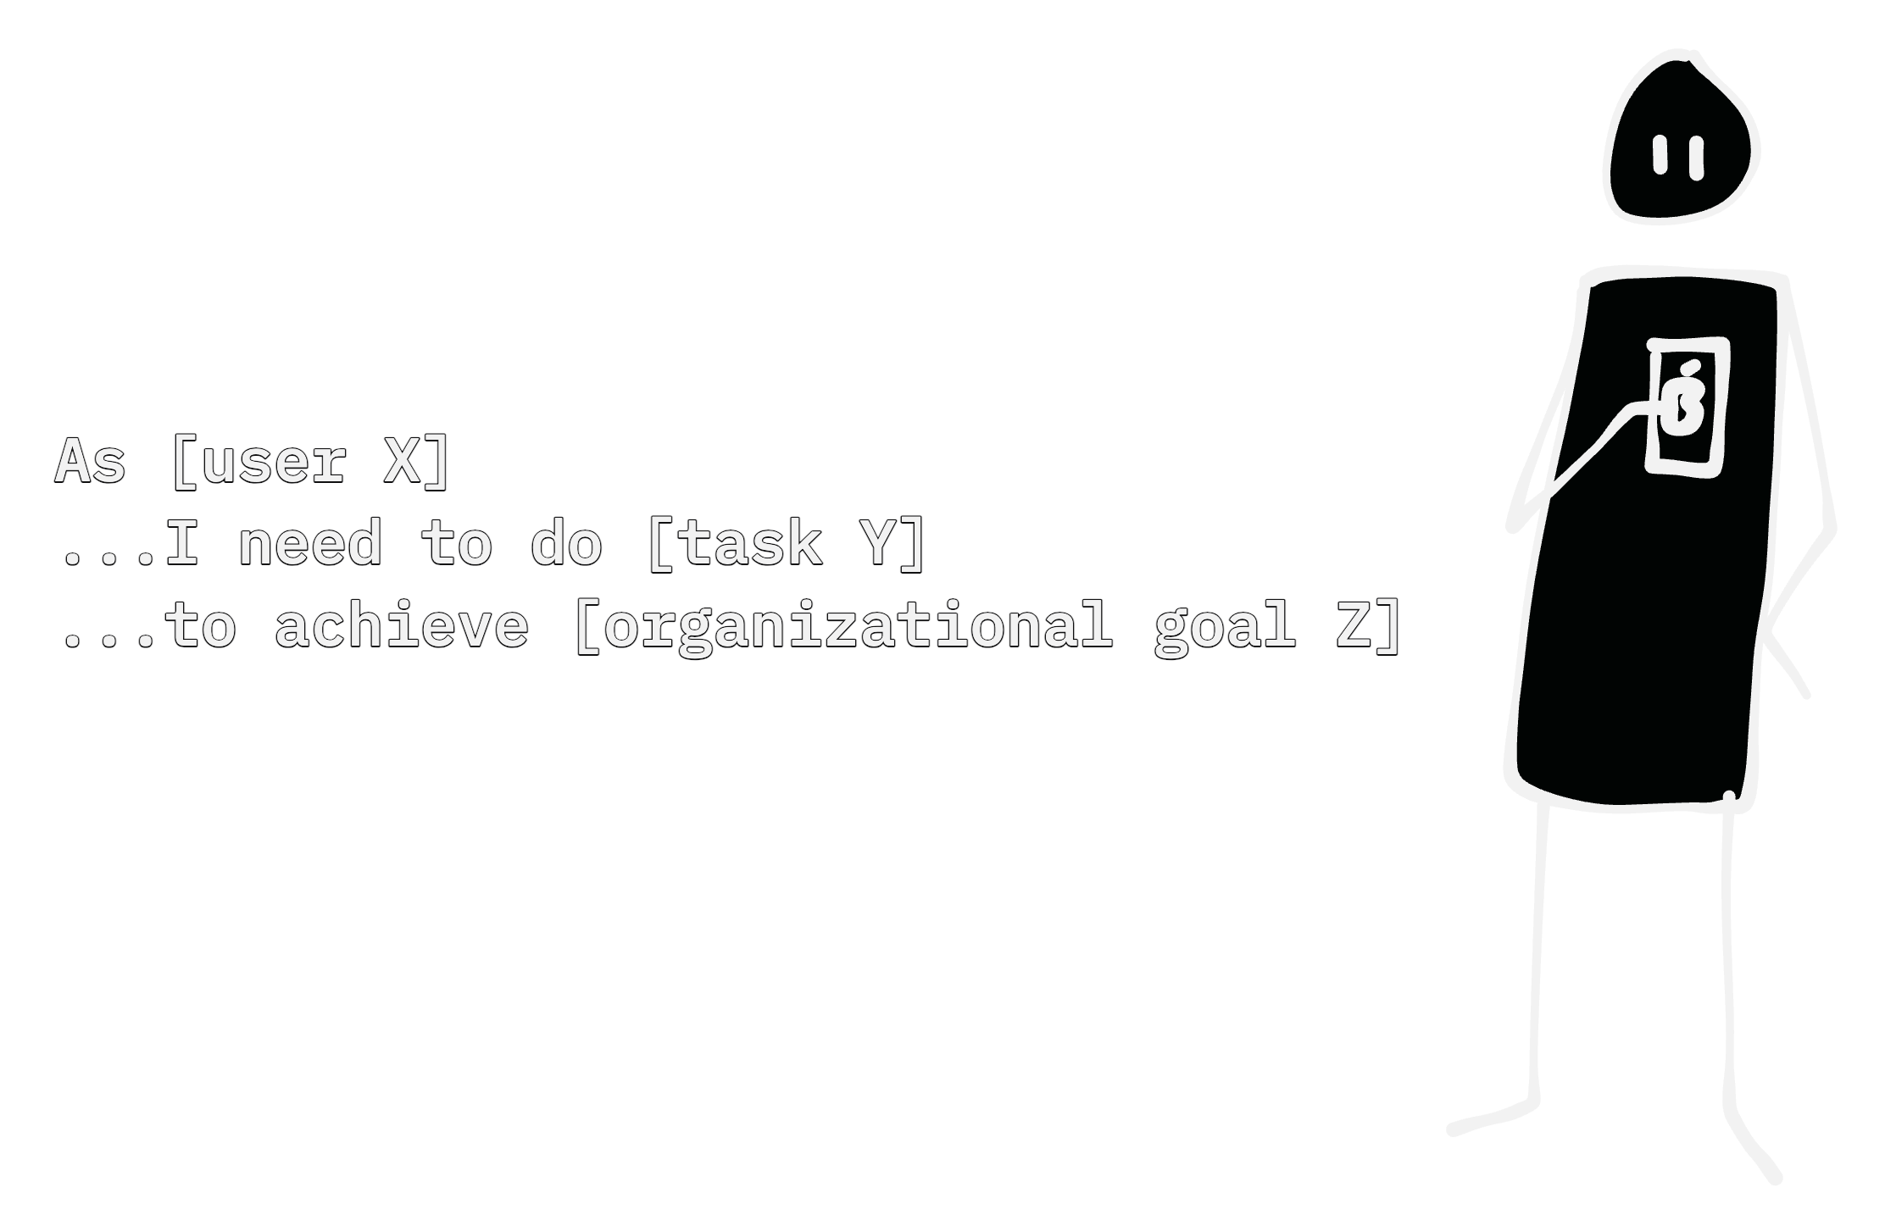
Notes:
Start with a problem you want to describe and/or solve. Maybe a user story, or something else.

Slide 42
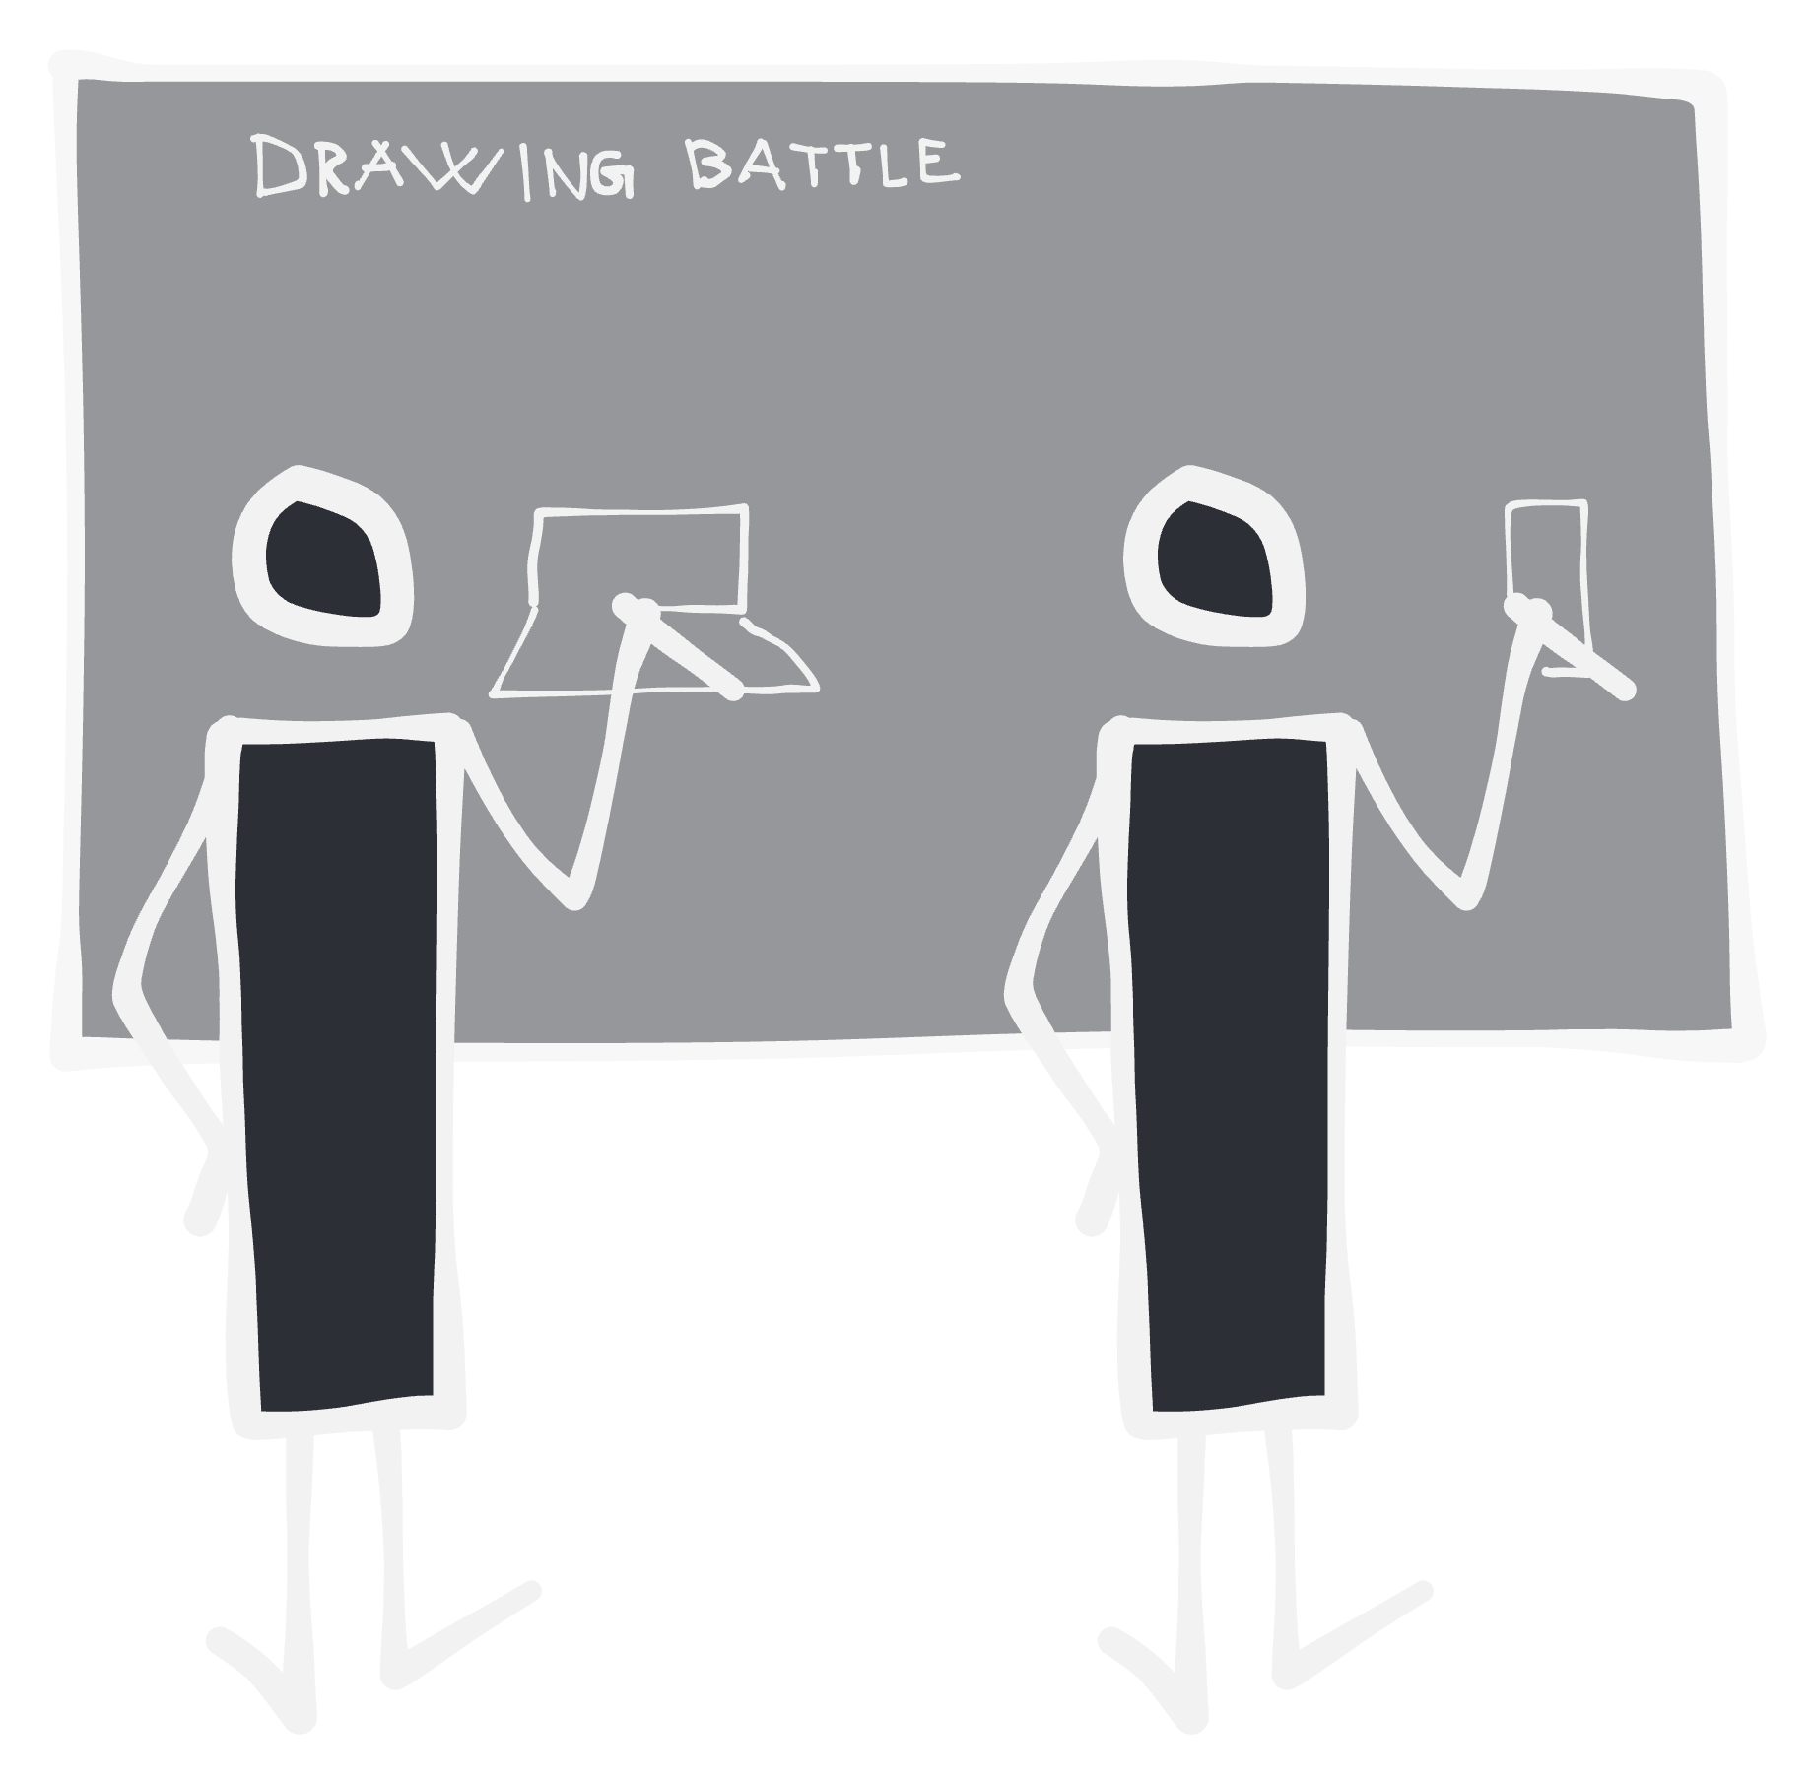
Notes:
Do a drawing battle. Everyone draws. You need at least two people.

Slide 43
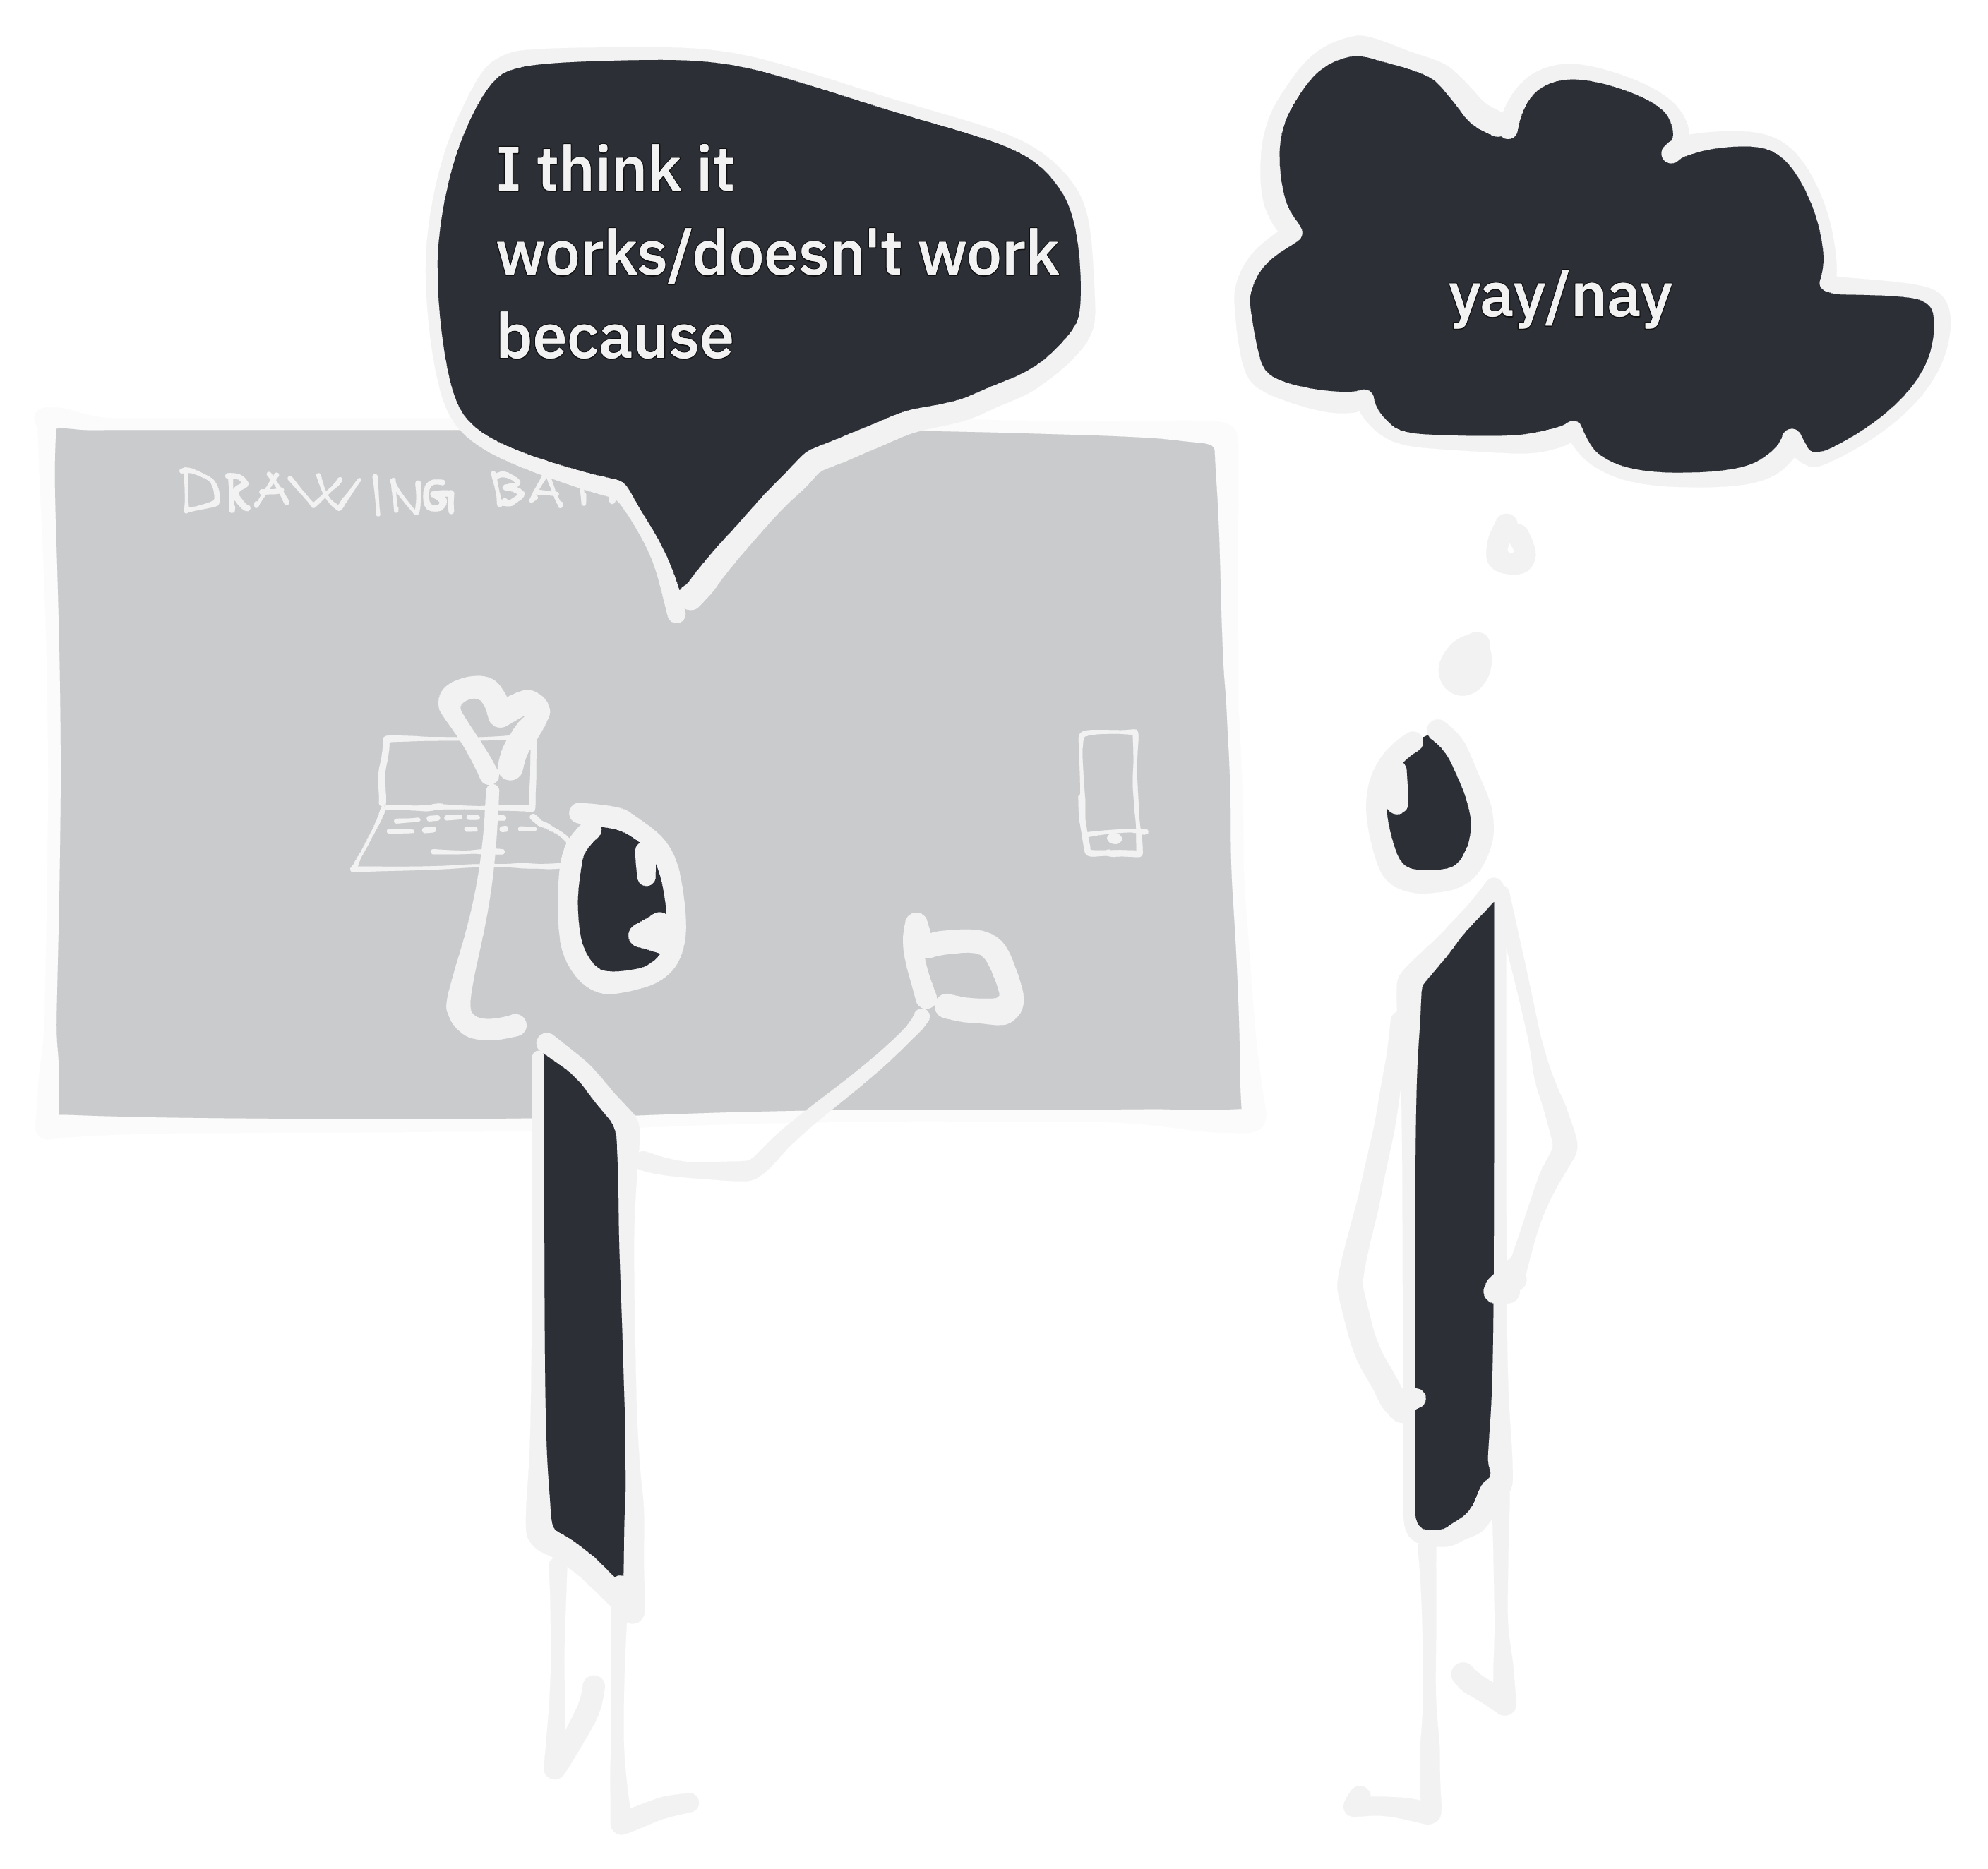
Notes:
Design critique is a really powerful discussion technique. Go through each person's dreawing and
Describe what you think works or doesn’t work with the drawing. And why.
It’s up to the recipient, the one that drew it, what you want to take away from the input. You can change course or double down on trying to make your initial solution work.
It's up to you, not the one giving the critique.

Slide 44
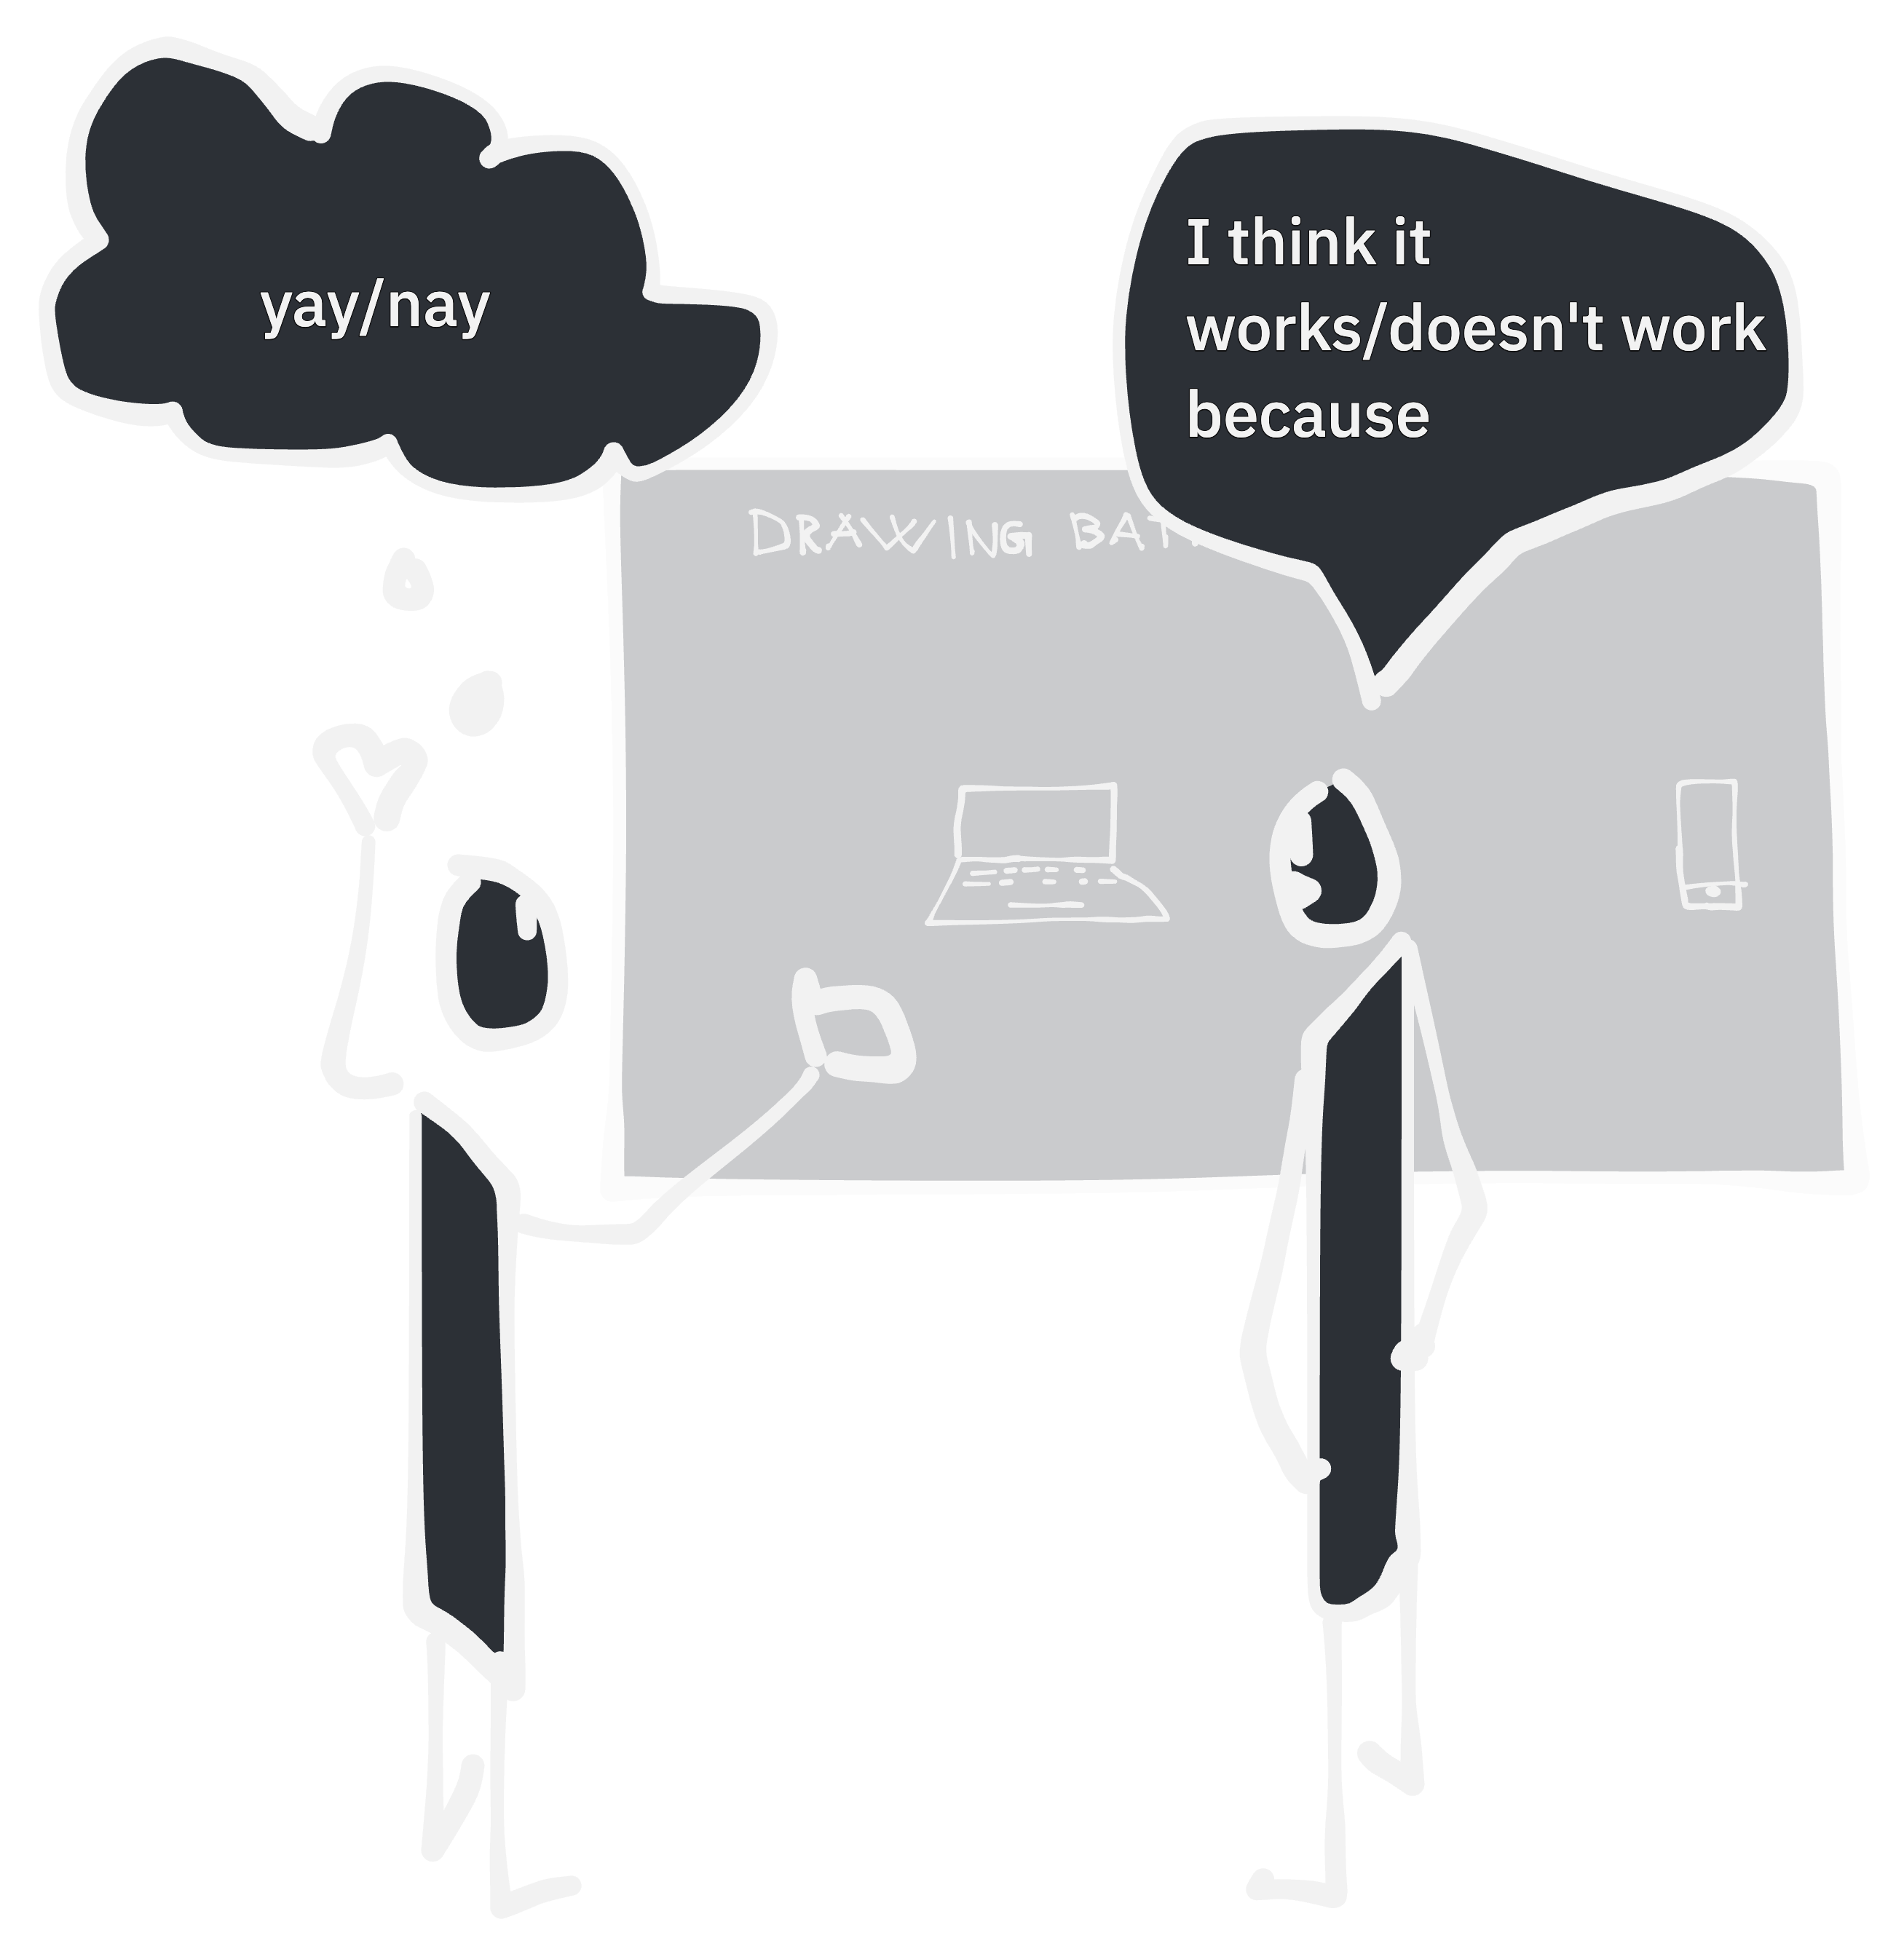
Notes:
Do this for every participant in the drawing battle.

Slide 45
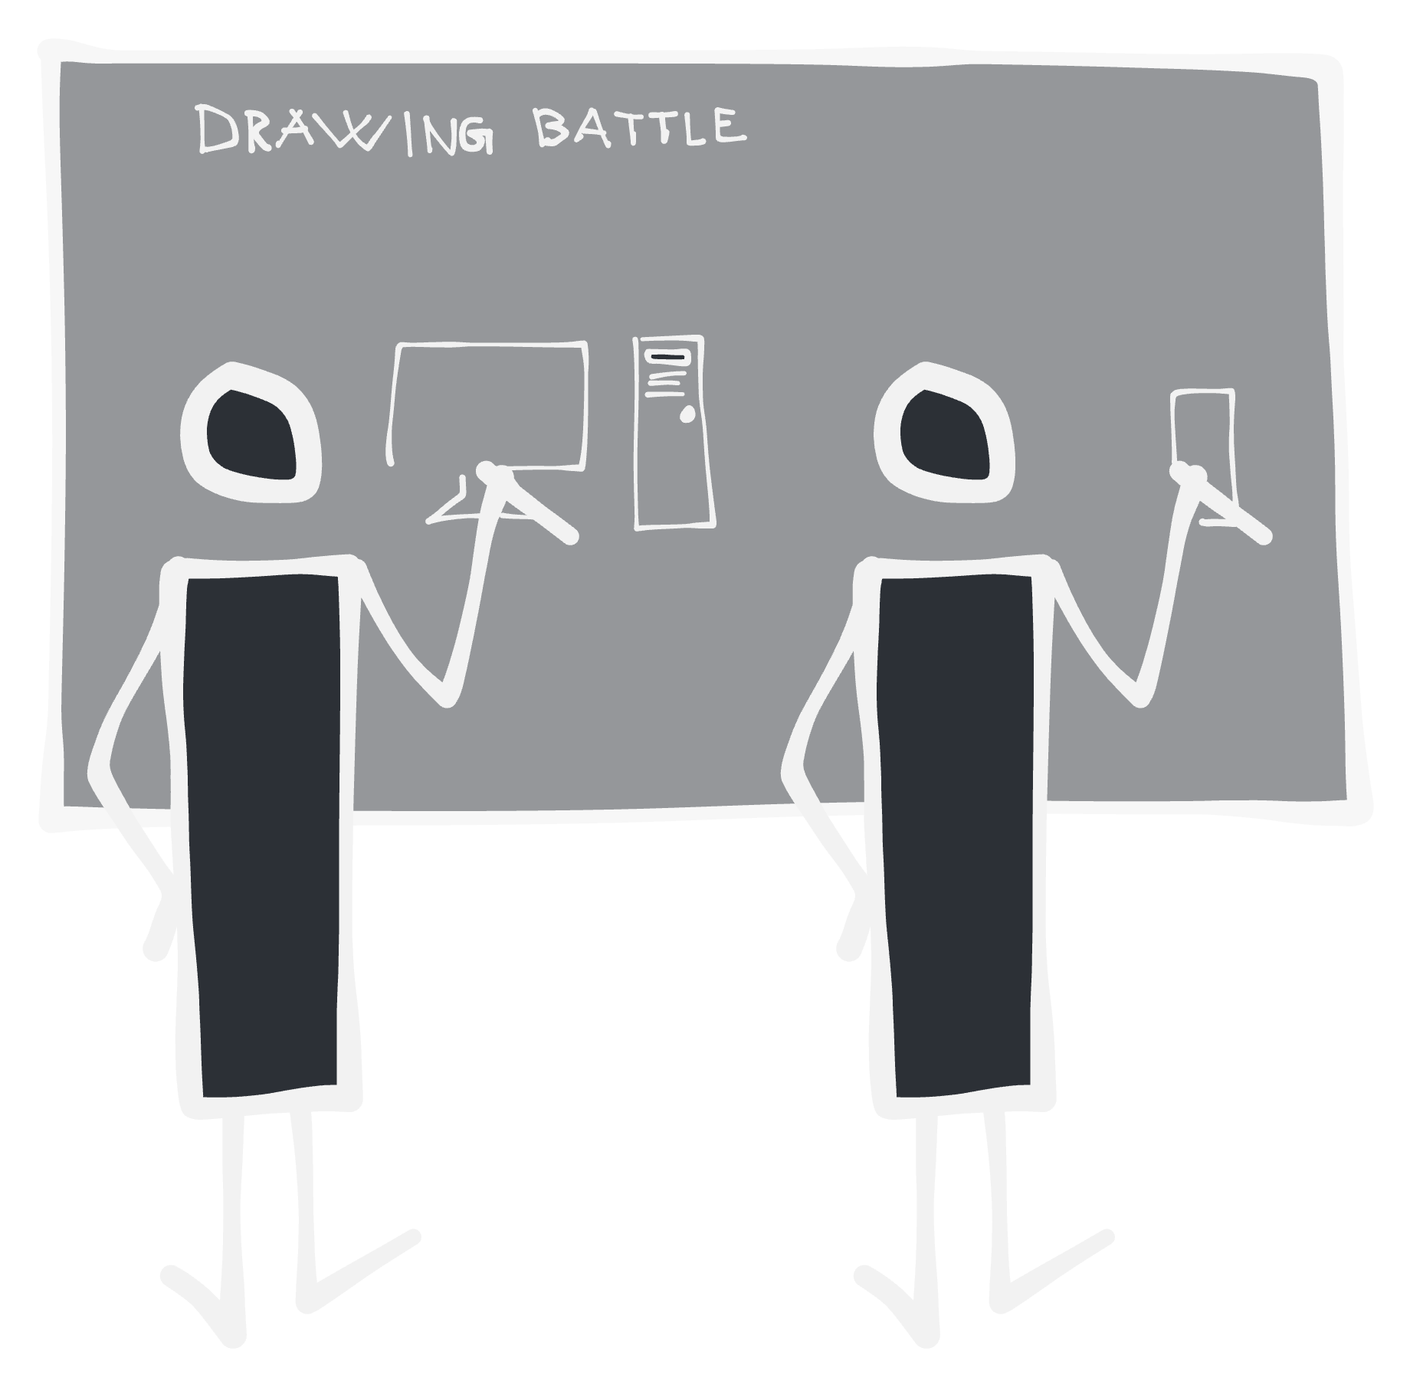
Notes:
And draw the same problem several times. You get to challenge your own ideas in your own tempo. And there doesn't need to be a winner, except everyone gets a bit more enlightened and aligned.

Slide 46
What the future may hold
Notes:
So, what the future may hold!

Slide 47
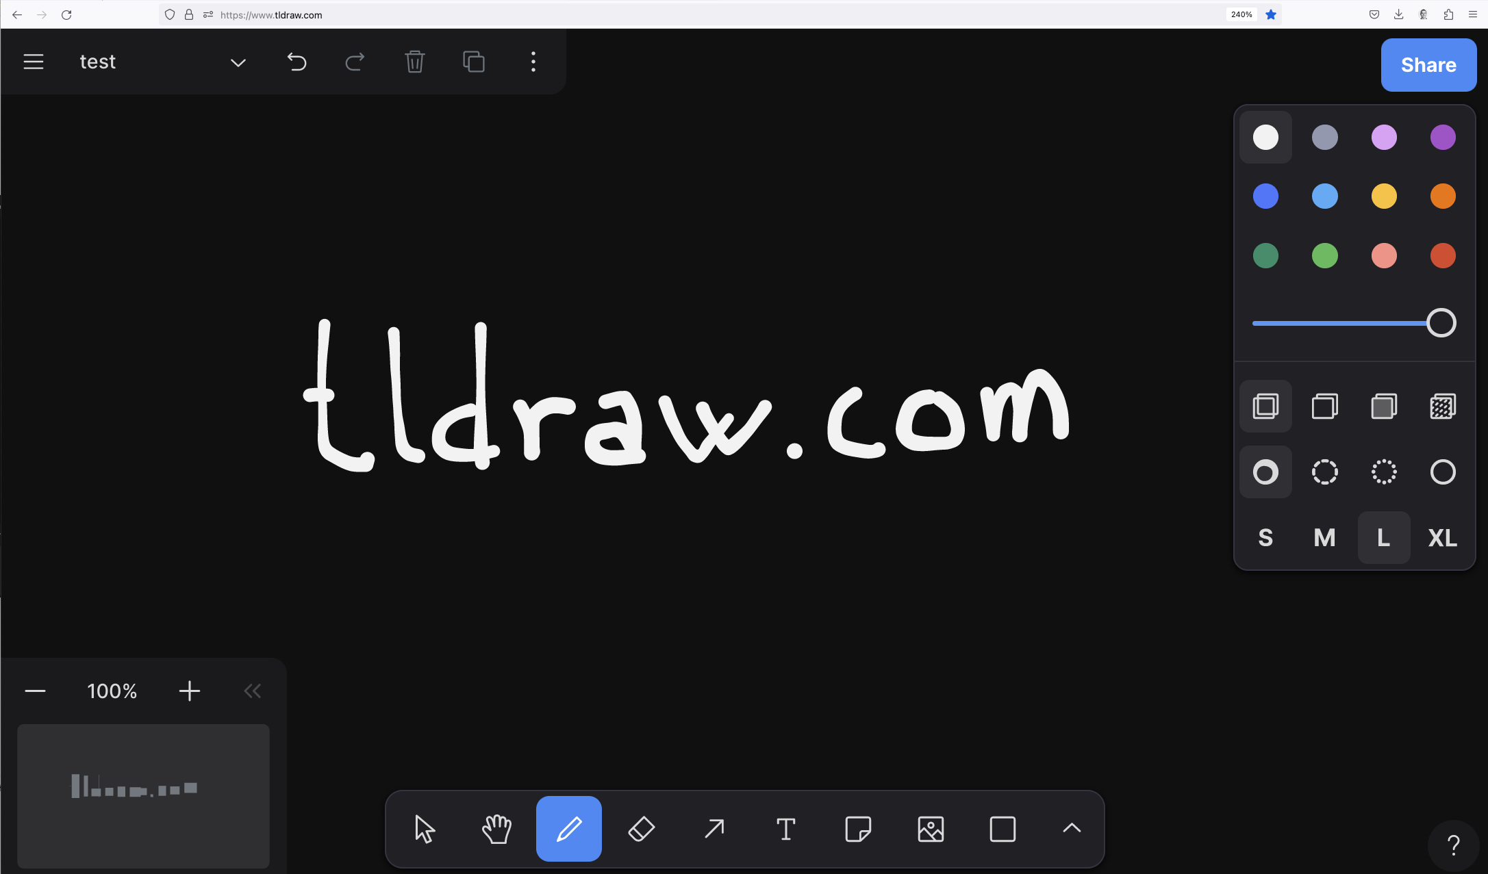
Notes:
Online, self service workshops through tldraw.com – Tiny little drawing app
Try to make something that is available when people are actually motivated.
It got all you need: * zoom
* panning
* endless canvas
* drawing pen with different thicknes and some colors. You don’t need a lot more.

Slide 48
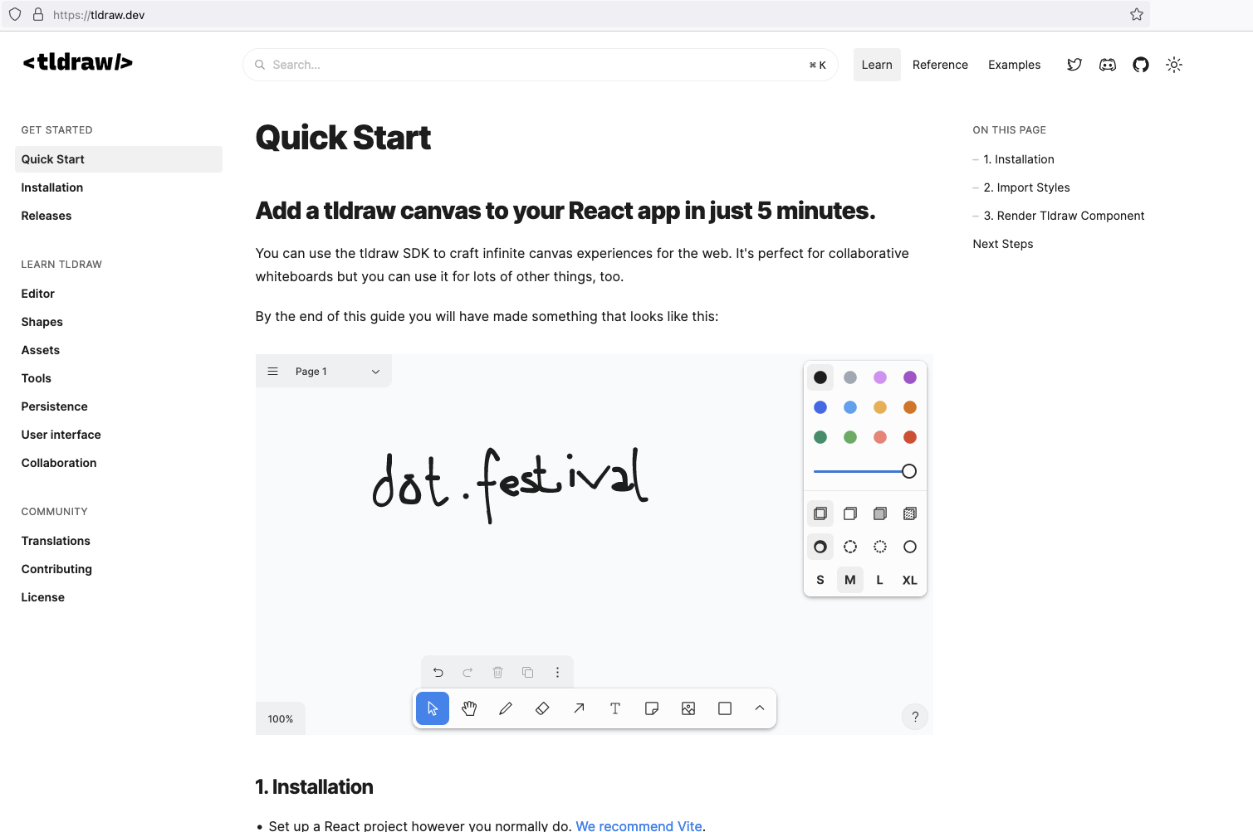
Notes:
A big difference between Miro and Tldraw is that you can build on top of Tldraw and create your own web application.
And you have quite thorough descriptions as to how. It was opensource, now it’s only free if what you make is free too. No problem for me.

Slide 49
Notes:
What I have done is to start translating the manned Miro workshop into...

Slide 50
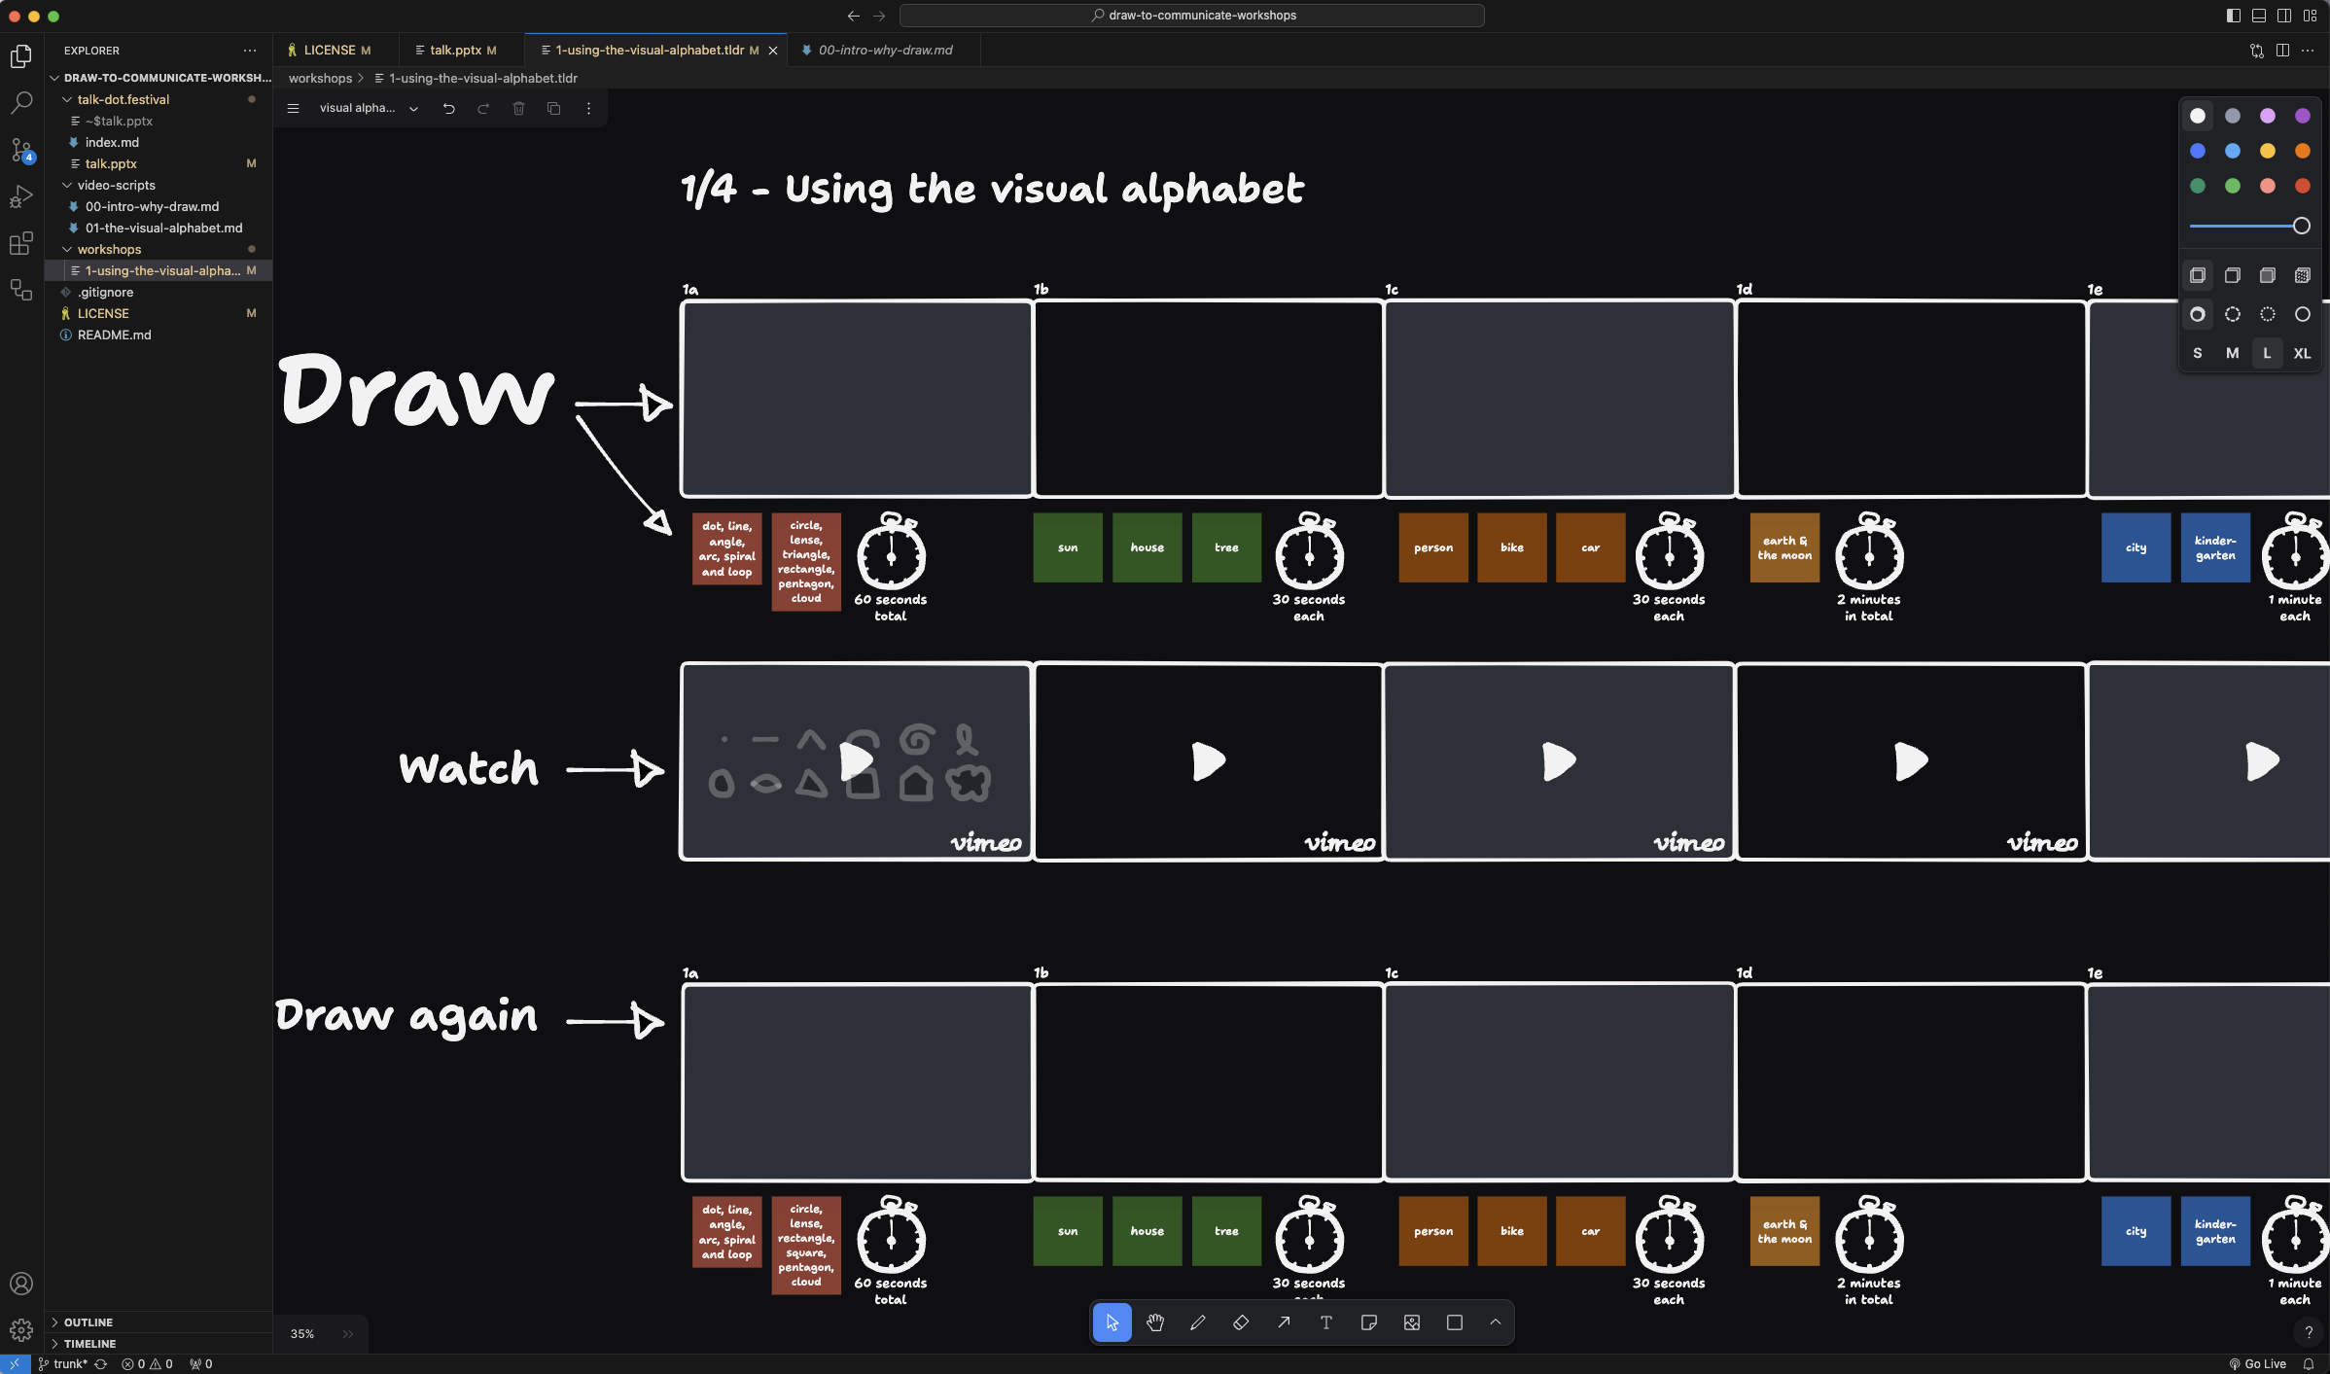
Notes:
... a self service workshop in tldraw.
Basically the setup is that you:
draw something
watch a video on how it could be done
draw again if you got some new ideas

Slide 51
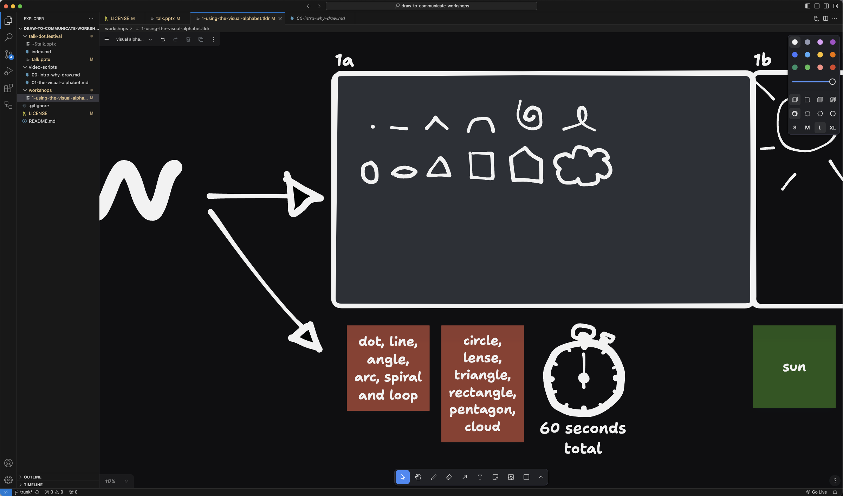
Notes:
Each board has a set of things you should draw and how long it should take.
I have yet to create the videos, but when I have, I’ll start sharing a bit more public.

Slide 52
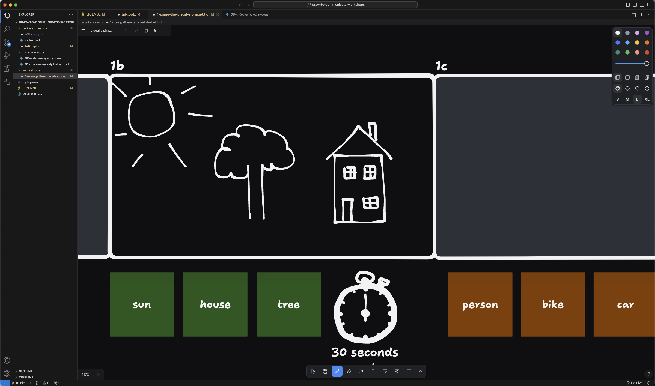
Notes:
The first workshop part takes you from childhood drawings...

Slide 53
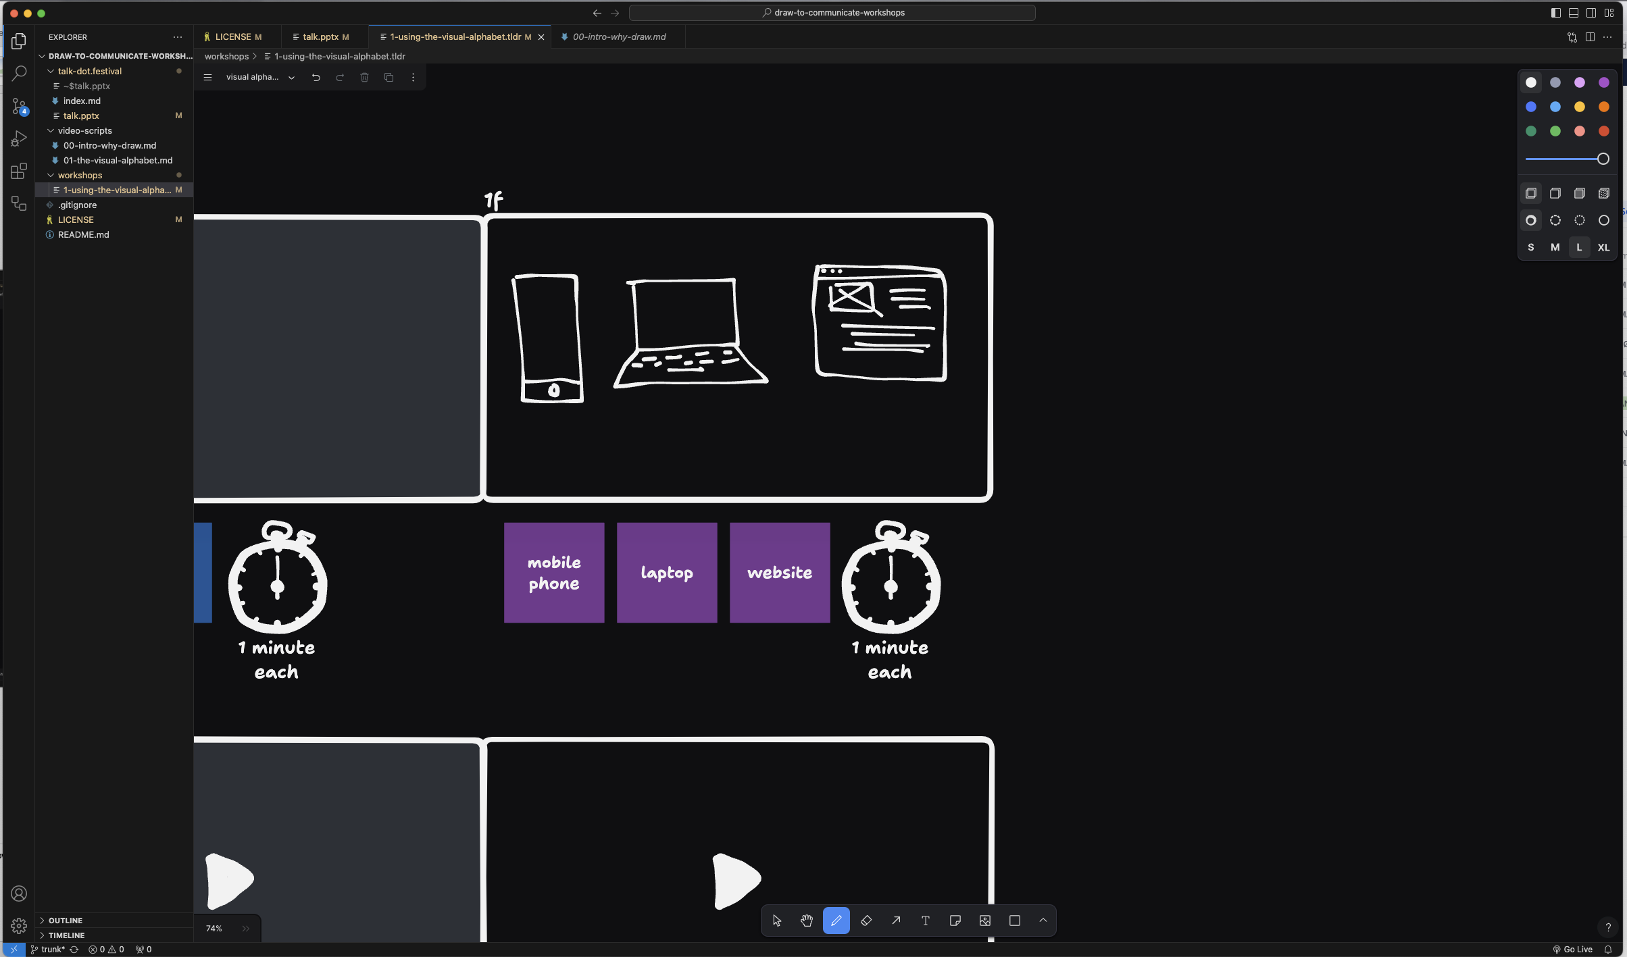
Notes:
... to something closer to usefull in our line of work.
But the first workshop part is still mostly to practice using the visual alphabet.

Slide 54
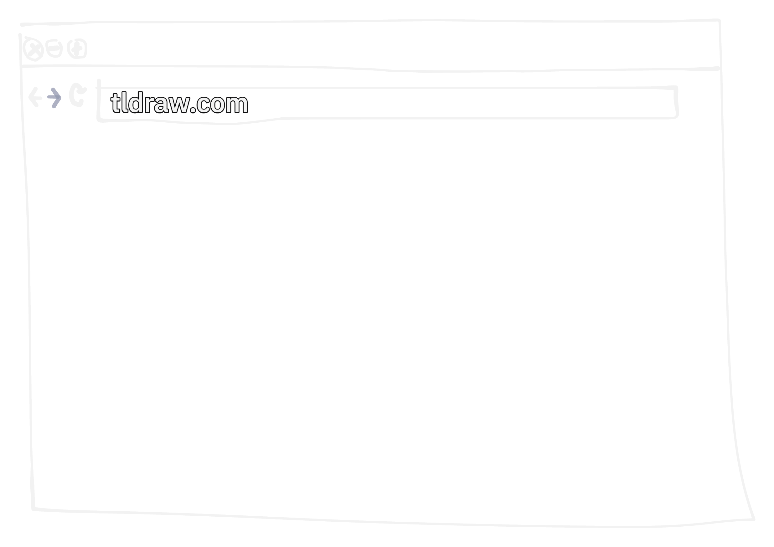
Notes:
If you want to now, you can open tldraw.com in your browser and open the .tldr-file I’ve posted in the random-channel on the dot.festival Slack.

Slide 55

Notes:
Questions?

Slide 56
Notes:
Thank you for your time!

